Slide 1
Introduction to Modern Cellular Networks Part 5: 4G LTE Radio Interface – Part 1
Dejan Vukobratovic, Professor

Slide 2
4G LTE Radio Interface
4G LTE radio interface is designed to deliver IP packets from the base station (eNB) to the mobile device (UE) in the downlink, or vice versa in the uplink
After processing IP packets on layer 2 via PDCP, RLC and MAC sublayers (see part 3 and 4 lectures), MAC frames are delivered to physical layer (PHY) for physical signal transmission
LTE PHY is the key part and it is worth introducing its basics!

Slide 3
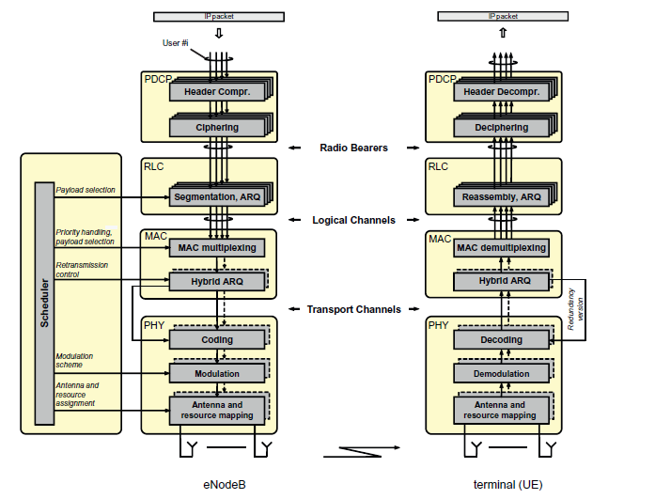
4G LTE PHY Signal Processing

Slide 4
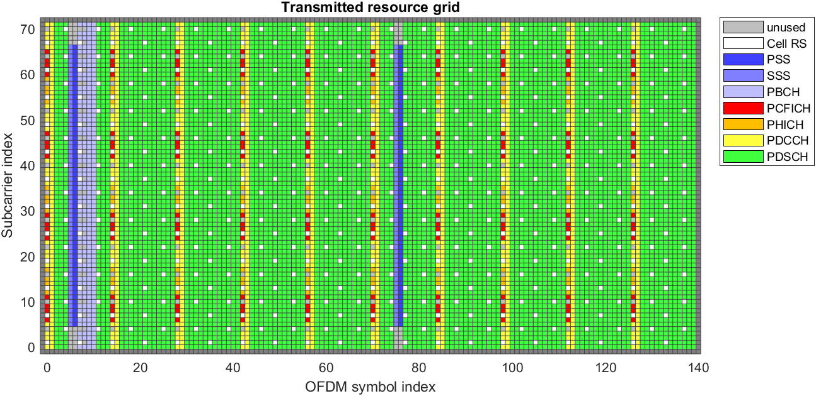
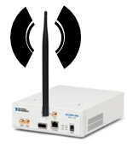
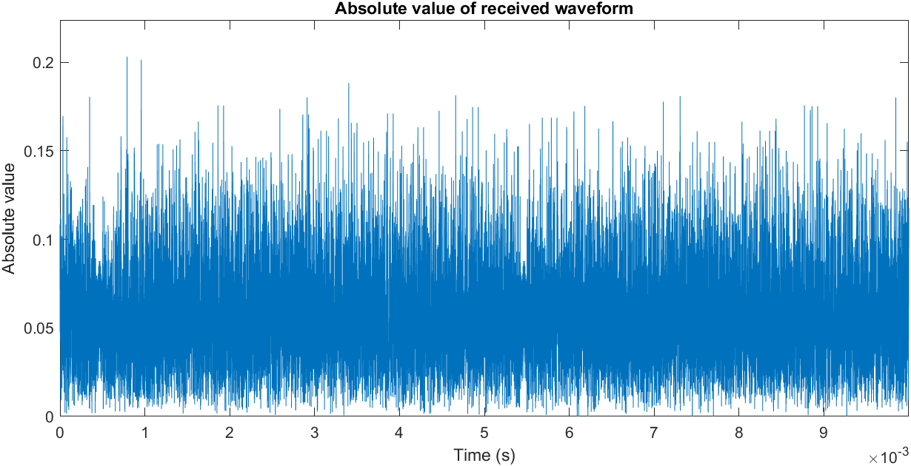
4G LTE PHY Signal Processing
0
1
0
0
0
1
1
0
1
0
1
1
0
K bits
MAC
PHY
Turbo Codes
CRC, FEC CODING, RATE MATCHING, SCRAMBLING
0
1
0
0
0
1
1
0
1
0
1
1
0
0
1
0
1
1
0
N bits
MODULATION, RESOURCE GRID MAPPING
QPSK, 16-QAM, 64-QAM
PHY signals
PHY channels
OFDM MODULATION
RF

Slide 5
4G LTE PHY Signal Processing
0
1
0
0
0
1
1
0
1
0
1
1
0
K bits
MAC
PHY
Turbo Codes
CRC, FEC CODING, RATE MATCHING, SCRAMBLING
0
1
0
0
0
1
1
0
1
0
1
1
0
0
1
0
1
1
0
N bits
MODULATION, RESOURCE GRID MAPPING
QPSK, 16-QAM, 64-QAM
PHY signals
PHY channels
OFDM MODULATION
RF

Slide 6
Outline of the Lecture
Basics on Error Correction Codes
Error Correction Coding in 4G LTE
Modulation Schemes in 4G LTE

Slide 7
Error Correction Mechanisms
Two main approaches to error correction
Forward Error Correction (FEC)
Use FEC encoding at the Tx side and FEC decoding at Rx side to achieve reliable information transmission across noisy channels
Implemented across message bits at the PHY layer (L1)
Automatic Repeat Request (ARQ)
Use feedback messages (ACK/NACK) to request packet retransmission
Implemented at the DLL layer (L2) – in 4G LTE that is RLC layer
Possible combination of FEC and ARQ is called Hybrid-ARQ

Slide 8
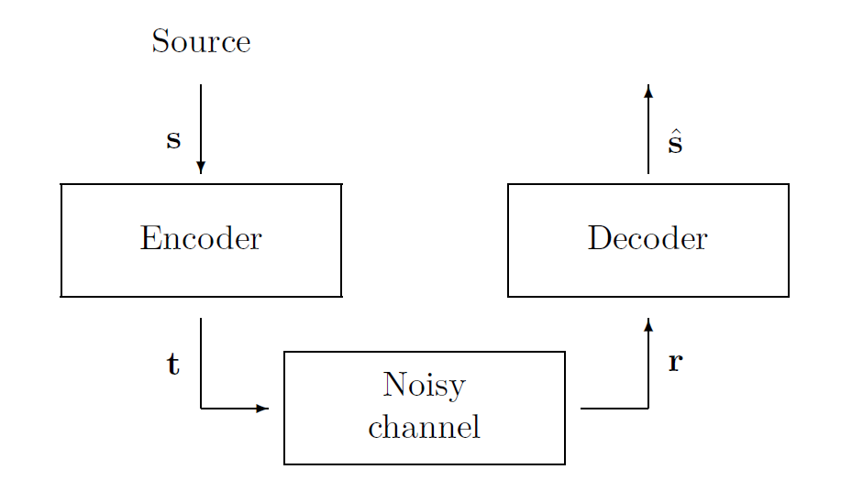
Forward Error Correction Solution
Use communication channel as it is!
Improve system design by including FEC encoder at the transmitter and FEC decoder at the receiver side
Digital FEC processing results in low-cost chip design and implementation
Figure: This figure is taken from D. MacKay: “Information Theory, Inference and Learning Algorithms,” Cambridge University Press, 2003 (Figure 1.6, page 5)

Slide 9
Forward Error Correction Solution
Basic Idea: Encode the binary information message by introducing (in a smart way) additional (redundant, protection) bits that will be used at the receiver to recover from channel-induced errors
Cost:
Message encoding at the transmitter
Message decoding at the receiver
Transmission of redundant bits
Benefit:
Reduction in bit error rates compared to uncoded data transmission over a given channel

Slide 10
Forward Error Correction Solution
Source message of length K bits
Encoder maps the source message 1-on-1 to a corresponding codeword of length N bits
In other words, adds N-K redundant bits
Codeword is transmitted over a noisy channel
Channel is defined using a channel model
Received sequence generally differs from a transmitted codeword
Taking received sequence as an input, Decoder provides an estimate of the transmitted codeword/source message

Slide 11
Code Rate
Code Rate is the main parameter of FEC encoded system
R = K/N
Describes number of information (useful) bits transmitted per each bit transmitted through the channel
0 ≤ R ≤ 1 (for binary input channels)
Target: Design FEC encoded system in which the probability of bit error tends to zero with as large as possible code rate R
The larger R, the less redundant bits are added

Slide 12
Channel Capacity
Question: With how high R we can go while keeping bit error probability P_{e} close to zero (reliable transmission)?

Slide 13
Outline of the Lecture
Basics on Error Correction Codes
Error Correction Coding in 4G LTE
Modulation Schemes in 4G LTE

Slide 14
Error Correction Coding in 4G LTE
Encoder/Decoder
CHANNEL

Slide 15
Error Correction Coding in 4G LTE
FEC coding is part of DL-SCH transport channel processing
Input from MAC layer – Transport Block (TB)
Step 1 – CRC Encoding
Attach 24-bit CRC-24 error detection code to TB
Allows for error detection at the receiver
Used to trigger HARQ retransmissions

Slide 16
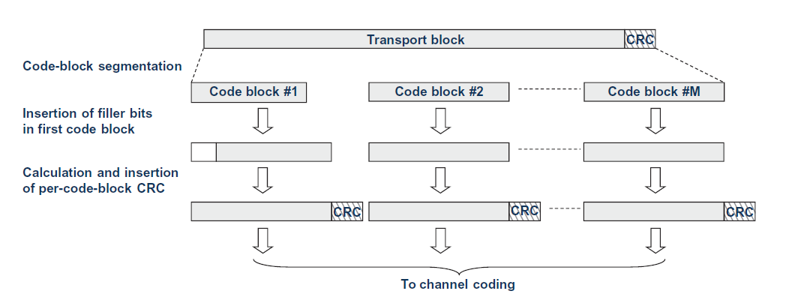
Error Correction Coding in 4G LTE
Step 2 – Code Block Segmentation
LTE Turbo Code has a limitation on the length of the input information sequence equal 6144 bits
If TB + CRC-24 exceeds this size: Code block segmentation
Figure: This figure is taken from E. Dahlman, S. Parkvall, J. Skoll: “4G LTE/LTE-Advanced for Mobile Broadband,” Academic Press (Elsevier), 2011 (Figure 10.2, page 145)

Slide 17
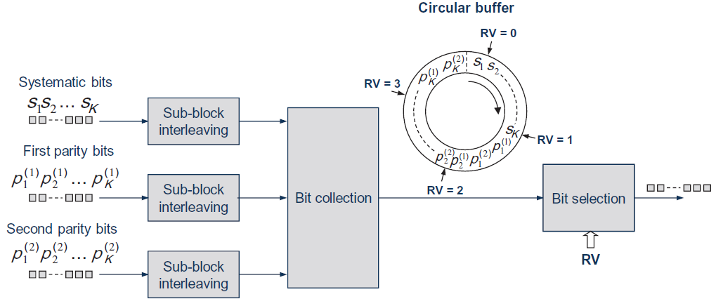
Error Correction Coding in 4G LTE
Step 3 – Turbo Coding
LTE uses R=1/3 Turbo Code, with input blocks from 40:6144 bits
Redundancy Version (RV) selection for HARQ is using circular buffer
Rate-matching matches No of bits to be transmitted to available resources
Step 4 – Scrambling
Randomizes interference from neighboring cells
Figure: This figure is taken from E. Dahlman, S. Parkvall, J. Skoll: “4G LTE/LTE-Advanced for Mobile Broadband,” Academic Press (Elsevier), 2011 (Figure 10.5, page 147)

Slide 18
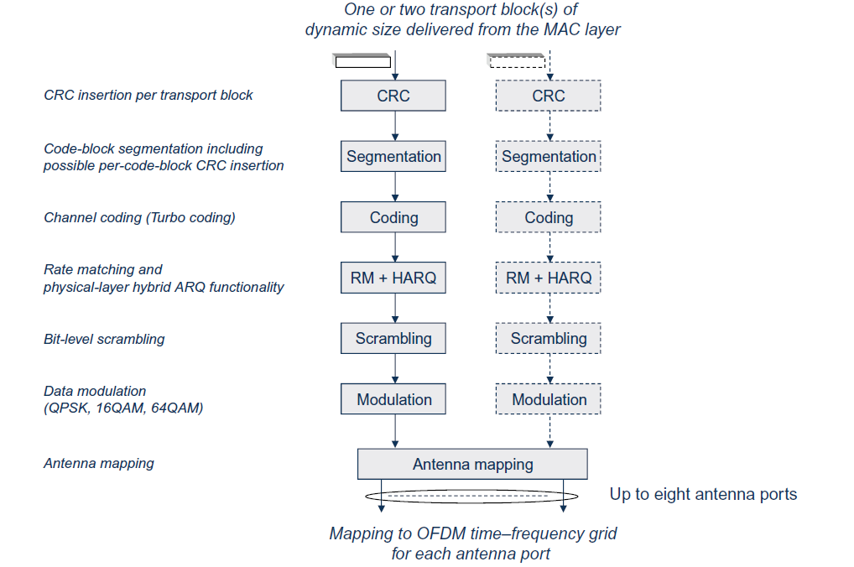
DL-SCH Transport Block Processing
Binary Sequence Processing
Complex Sequence Processing
Figure: This figure is taken from E. Dahlman, S. Parkvall, J. Skoll: “4G LTE/LTE-Advanced for Mobile Broadband,” Academic Press (Elsevier), 2011 (Figure 10.1, page 144)

Slide 19
4G LTE PHY Signal Processing
0
1
0
0
0
1
1
0
1
0
1
1
0
K bits
MAC
PHY
Turbo Codes
CRC, FEC CODING, RATE MATCHING, SCRAMBLING
0
1
0
0
0
1
1
0
1
0
1
1
0
0
1
0
1
1
0
N bits
MODULATION, RESOURCE GRID MAPPING
QPSK, 16-QAM, 64-QAM
PHY signals
PHY channels
OFDM MODULATION
RF

Slide 20
Outline of the Lecture
Basics on Error Correction Codes
Error Correction Coding in 4G LTE
Modulation Schemes in 4G LTE

Slide 21
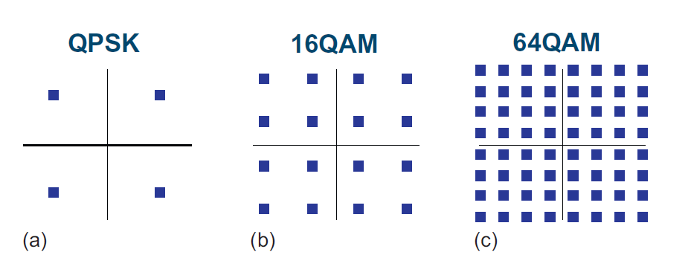
Modulation Schemes in 4G LTE
Modulation schemes used in LTE include:
QPSK (Quadrature Phase Shift Keying)
16-QAM (Quadrature Amplitude Modulation)
64-QAM (Quadrature Amplitude Modulation)

Slide 22
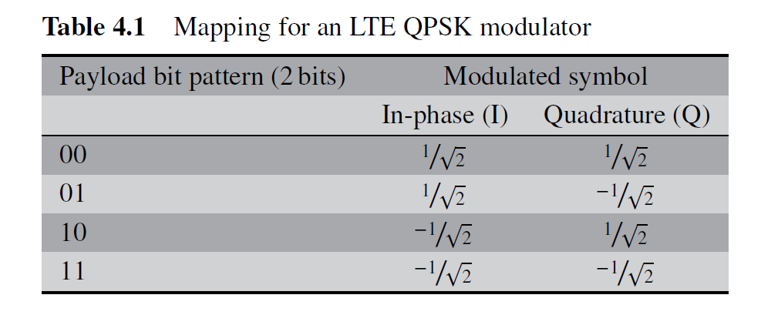
QPSK Modulation in 4G LTE
QPSK maps two input bits to one of four modulation symbols
Mapping scheme is presented in the table below
Figure: This table is taken from Zarrinkoub, H., “Understanding LTE with MATLAB: from mathematical modeling to simulation and prototyping,” John Wiley & Sons (Table 4.1, page 73)

Slide 23
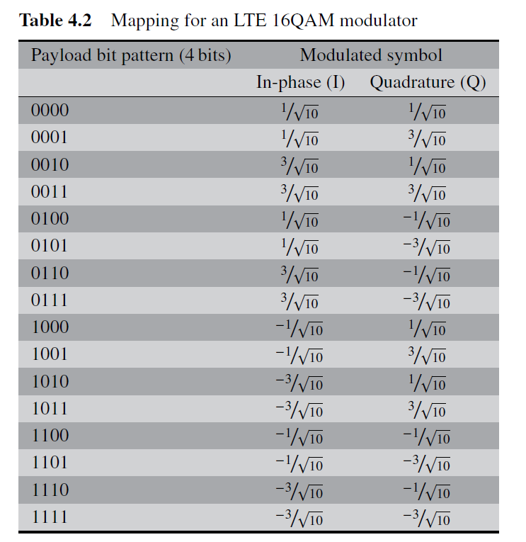
16-QAM Modulation in 4G LTE
16-QAM maps four input bits to one of 16 modulation symbols
Mapping scheme is presented in the table to the right
Figure: This table is taken from Zarrinkoub, H., “Understanding LTE with MATLAB: from mathematical modeling to simulation and prototyping,” John Wiley & Sons (Table 4.2, page 73)

Slide 24
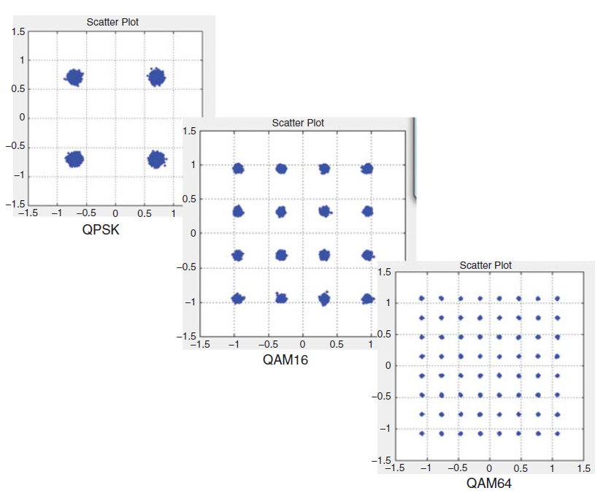
64-QAM Modulation in 4G LTE
64-QAM maps six input bits to one of 64 modulation symbols
Multiple available modulation schemes are instrumental for Adaptive Coding and Modulation
Based on received Signal-to-Noise Ratio (SNR) the device switches between modulation schemes

Slide 25
Takeaway Message
We reviewed basics of Forward Error Correction coding and its connection to Channel Capacity in Information Theory
We explained how Turbo Codes are applied in LTE physical layer, along with CRC detection, code block segmentation and scrambling
We presented basic Modulation schemes used in 4G LTE and presented their constellation diagrams

Slide 26
Introduction to Modern Cellular Networks Part 5: 4G LTE Radio Interface – Part 1
Dejan Vukobratovic, Professor

