Slide 1
Introduction to Modern Cellular Networks Part 9: 5G New Radio
Dejan Vukobratovic, Professor

Slide 2
Outline of the Lecture
5G NR Main Features
5G NR Transmission Structure

Slide 3
5G New Radio Development
Technical work on 5G NR initiated in Spring 2016
First version of 5G specifications in late 2017 (Release 15)
Limited to Non-Stand-Alone (NSA) solution
Focus was on eMBB and URLLC services
mMTC continues development of 4G eMTC/NB-IoT standards
Figure: This figure is taken from E. Dahlman, S. Parkvall, J. Skoll: “5G NR-Next Generation Wireless Access Technology,” Academic Press (Elsevier), 2017 (Figure 5.1, page 58)

Slide 4
5G New Radio – Main Features
Compared to LTE, NR provides many benefits:
Exploitation of higher-frequency bands to obtain additional spectra to support very wide transmission bandwidths and the associated high data rates
Ultra-lean design to enhance network energy performance and reduce interference
Forward compatibility to prepare for future, yet unknown, use cases
Low latency to improve performance and enable new use cases;
Beam-centric design enabling extensive usage of beamforming and massive number of antenna elements (more than is possible in LTE)

Slide 5
Exploitation of Higher Frequency Bands
mmWave band offers large amount of spectra/wideband channels
Very high capacity and extreme data rates
Problem is high attenuation and limited coverage
Partially compensated by MIMO beamforming technology
Problem still remains in Non-Line-of-Sight (NLOS) and outdoor-to-indoor
Operation in 3.5 GHz band will still remain fundamental
Combination of 3.5 GHz and 26-28 GHz band will be suitable solution
mmWave will serve as load reduction on insufficient 3.5 GHz band

Slide 6
Ultra Lean Design
Current mobile cellular networks suffer from high amount of “always-on” signals independent of user data
Signals for base station detection
Broadcast of system information
Reference signals for channel estimation
In densely deployed wideband technologies such as 5G NR, amount of this signals would increase compared to 4G LTE, and thus:
Impose upper limit on network energy efficiency
Increase inter-cell interference
Ultra-lean design aims at reducing/eliminating always-on signals

Slide 7
Forward Compatibility
5G NR aims at ensuring high degree of forward compatibility
Radio-interface design that allows for substantial future evolution of technology and services with yet unknown requirements and characteristics
Support legacy devices on the same carrier.
Maximizing the amount of time and frequency resources that can be flexibly utilized or can be left blank without causing backward compatibility issues in the future;
Minimizing transmission of always-on signals;
Confining signals and channels for physical layer functionalities within a configurable/allocable time-frequency resource.

Slide 8
Low Latency
5G NR introduces significant changes in order to accommodate low latency requirements
Front Loaded Reference and Control Data (at the beginning of the slot)
“Mini-slot” transmission – possibility to transmit over a part of the slot
Reduced response times for several key procedures
HARQ feedback
Random Access Grant response time
Higher layer protocols (MAC, RLC) redesigned for low latency
Headers can be inserted without knowledge of amount of data to be transmitted

Slide 9
Beam Centric Design
Support for a for a large number of steerable antenna elements for both transmission and reception is a key feature of NR
At higher-frequency bands, the large number of antennas are used for beamforming to extend coverage
At lower-frequency bands they enable Massive MIMO
At mmWave, both digital beamforming/precoding and analog beamforming is supported
This includes additional beam sweeping, tracking and management
For Massive MIMO, up to 8 layers in DL and 4 in UL is supported
Support for Distributed MIMO (Cell-Free MIMO)

Slide 10
Outline of the Lecture
5G NR Main Features
5G NR Transmission Structure

Slide 11
5G NR Transmission Scheme
5G NR adopts OFDM as a transmission waveform in both DL and UL
In 4G LTE, DFT precoded OFDM is used, which is not adopted in 5G
OFDM Numerology: Subcarrier spacing and cyclic prefix length
Subcarrier spacing needs to carefully balance overhead from the cyclic prefix against sensitivity to Doppler spread/shift and phase noise
LTE uses 15 kHz carrier spacing and 4.7 μs CP length
Suitable for outdoor macro-cells at approx. 3 GHz carrier frequency
5G NR deals with much wider possible scenarios
Wide range of frequencies and cell ranges
Single numerology cannot satisfy all scenarios

Slide 12
5G NR Numerology
5G NR numerology is based on multiples of 15 kHz spacing
15 kHz is kept for backward compatibility with LTE and NB-IoT
For higher bands and smaller cells, larger carrier spacing is used
Figure: This table is taken from E. Dahlman, S. Parkvall, J. Skoll: “5G NR-Next Generation Wireless Access Technology,” Academic Press (Elsevier), 2017 (Table 7.1, page 105)

Slide 13
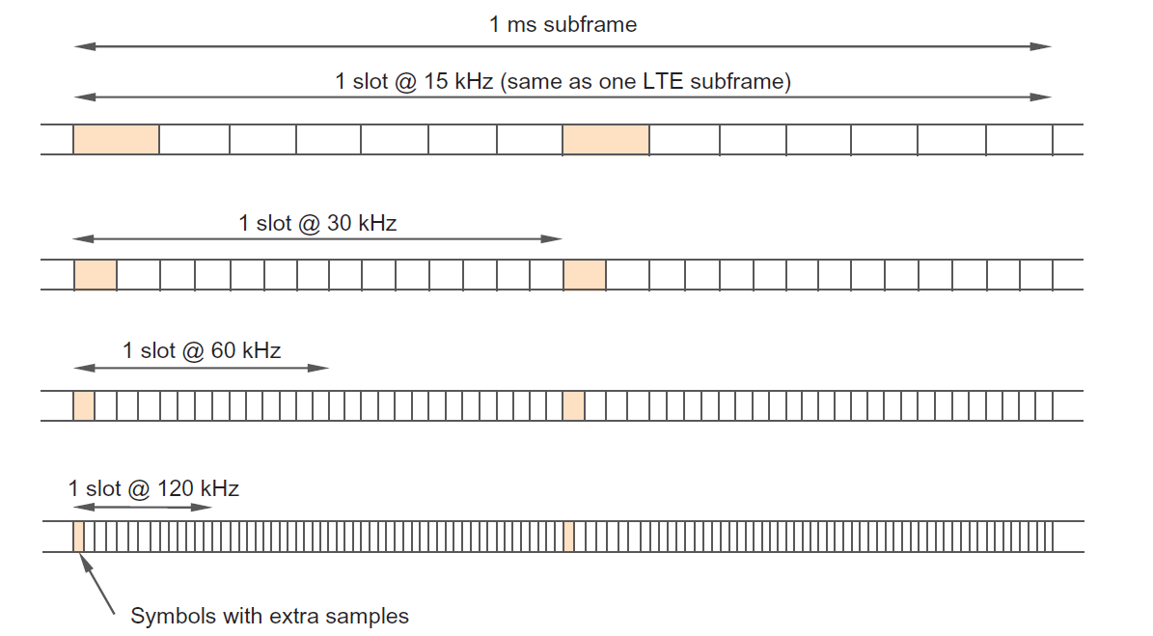
5G NR Numerology
5G NR numerology in time domain
Figure: This figure is taken from E. Dahlman, S. Parkvall, J. Skoll: “5G NR-Next Generation Wireless Access Technology,” Academic Press (Elsevier), 2017 (Figure 7.1, page 106)

Slide 14
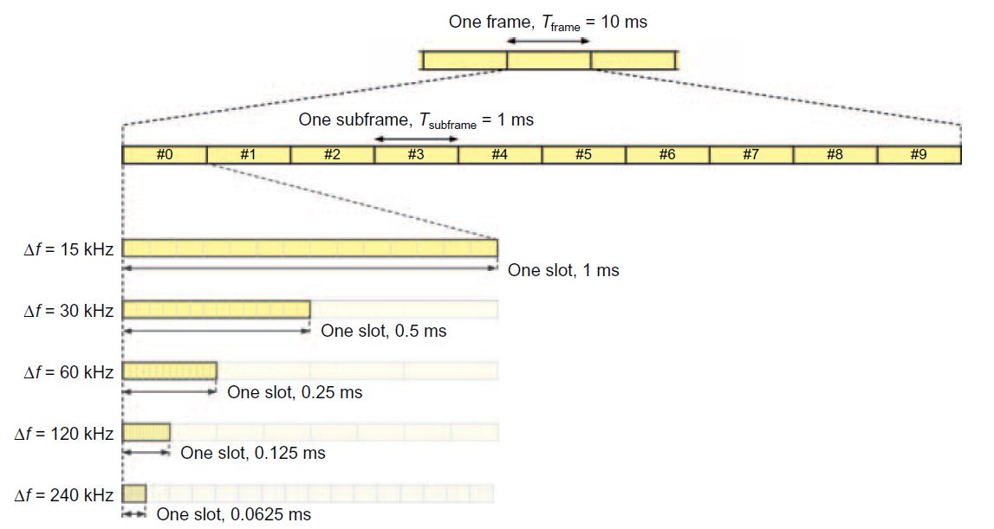
5G NR Time Domain Structure
Frame, subframe and slot structure in 5G NR
Figure: This figure is taken from E. Dahlman, S. Parkvall, J. Skoll: “5G NR-Next Generation Wireless Access Technology,” Academic Press (Elsevier), 2017 (Figure 7.2, page 107)

Slide 15
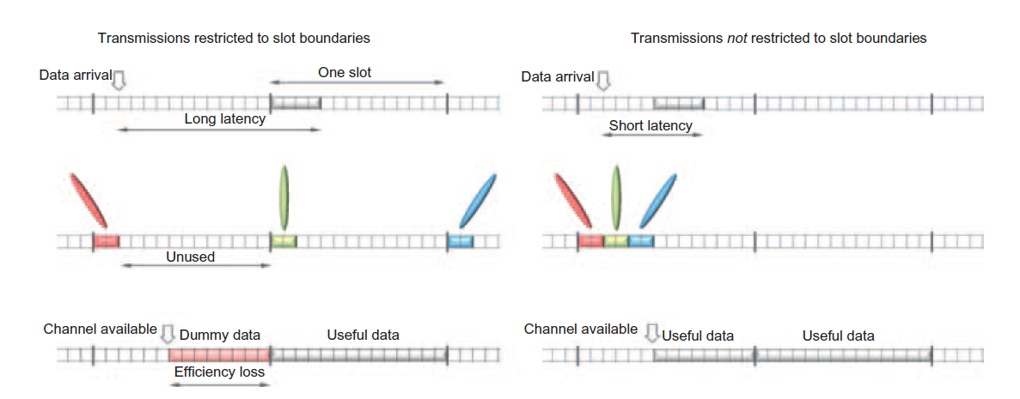
5G NR Time Domain Structure
5G NR supports mini-slot transmission
Decoupling transmission from slot boundaries
Examples: low latency, beam-sweeping, unlicenced band access
Figure: This figure is taken from E. Dahlman, S. Parkvall, J. Skoll: “5G NR-Next Generation Wireless Access Technology,” Academic Press (Elsevier), 2017 (Figure 7.3, page 108)

Slide 16
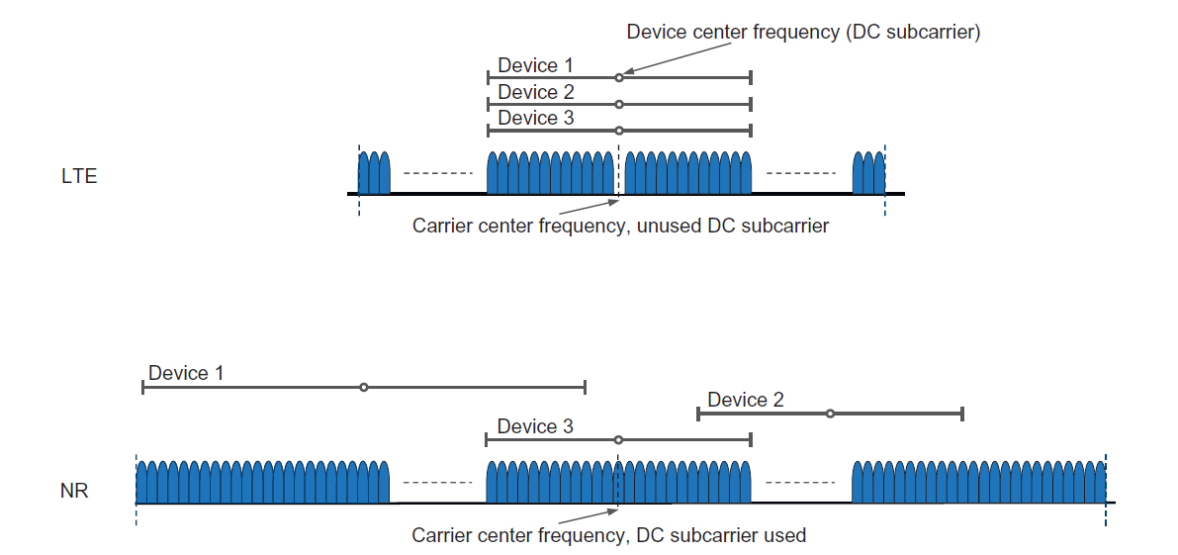
5G NR Frequency Domain Structure
5G NR supports bandwidths of up to 400 MHz on a single carrier
In NR, devices may not be able to receive the whole band and may not be centered around the carrier frequency
Figure: This figure is taken from E. Dahlman, S. Parkvall, J. Skoll: “5G NR-Next Generation Wireless Access Technology,” Academic Press (Elsevier), 2017 (Figure 7.4, page 110)

Slide 17
5G NR Frequency Domain Structure
NR supports multiple numerologies on the same carrier and, consequently, there are multiple resource sets of resource grids
Figure: This figure is taken from E. Dahlman, S. Parkvall, J. Skoll: “5G NR-Next Generation Wireless Access Technology,” Academic Press (Elsevier), 2017 (Figure 7.6, page 111)

Slide 18
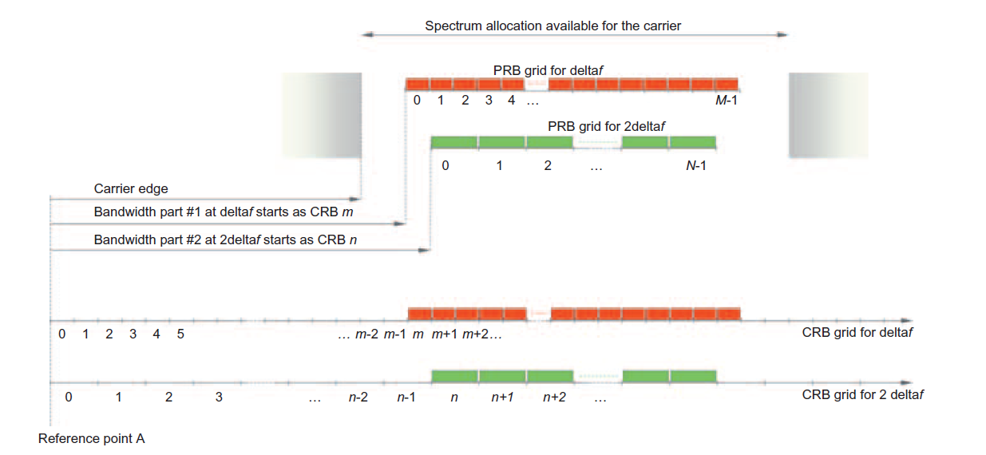
5G NR Frequency Domain Structure
Position of NR signals of different bandwidths (CRB and PRB)
Figure: This figure is taken from E. Dahlman, S. Parkvall, J. Skoll: “5G NR-Next Generation Wireless Access Technology,” Academic Press (Elsevier), 2017 (Figure 7.7, page 111)

Slide 19
Bandwidth Parts
In 5G NR, it is not mandatory for a device to receive the full carrier bandwidth, given the very wide carrier bandwidth supported.
Receiving wide bandwidth can be very energy costly
NR supports receiver-bandwidth adaptation
Device uses narrower bandwidth to monitor control channels and handle low intensity traffic, and expands bandwidth for high intensity traffic
Bandwidth Part (BWP): Defined by a numerology (subcarrier spacing and cyclic prefix) and a set of consecutive resource blocks in the numerology of BWP, starting at a certain common RB (CRB)

Slide 20
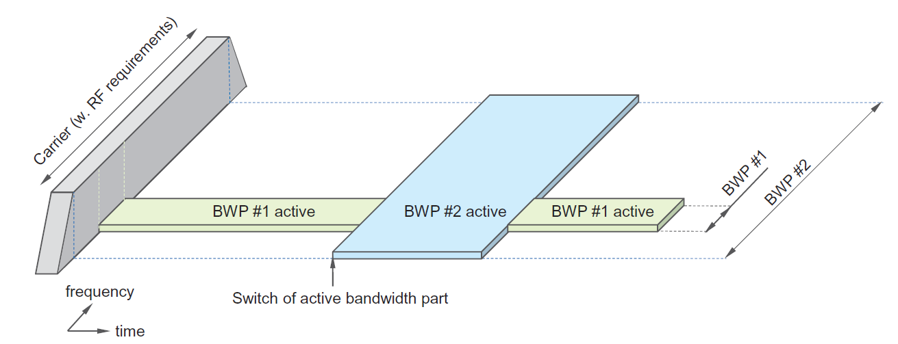
Bandwidth Parts
When device enters Connected state, it reads PBCH and obtains initial BWP information
Up to 4 BWP in both DL and UL can be defined per device
eNB activates a single active UL and DL BWP in any time instant
Figure: This figure is taken from E. Dahlman, S. Parkvall, J. Skoll: “5G NR-Next Generation Wireless Access Technology,” Academic Press (Elsevier), 2017 (Figure 7.8, page 113)

Slide 21
Carrier Aggregation and Supplementary Uplink
Similar to LTE, NR supports three types of CA:
Intra-band aggregation with frequency-contiguous component carriers
Intra-band aggregation with non-contiguous component carriers
Inter-band aggregation with non-contiguous component carriers
Up to 16 carriers can be aggregated to support 16*0.4 = 6.4 GHz
NR also supports so-called “supplementary uplink” (SUL)
Aim of SUL is to extend uplink coverage, providing higher uplink data rates by utilizing the lower path loss at lower frequencies.
Figure: This figure is taken from E. Dahlman, S. Parkvall, J. Skoll: “5G NR-Next Generation Wireless Access Technology,” Academic Press (Elsevier), 2017 (Figure 7.3, page 118)

Slide 22
Duplex Schemes
NR supports separation of uplink and downlink in time and/or frequency subject to either half duplex or full duplex operation
TDD: uplink and downlink transmissions use the same carrier frequency and are separated in time only
FDD: uplink and downlink transmissions use different frequencies but can occur simultaneously;
Half-duplex FDD: uplink and downlink transmissions are separated in frequency and time, suitable for simpler devices operating in paired spectra
Figure: This figure is taken from E. Dahlman, S. Parkvall, J. Skoll: “5G NR-Next Generation Wireless Access Technology,” Academic Press (Elsevier), 2017 (Figure 7.15, page 121)

Slide 23
Time Division Duplex in 5G NR
Single carrier frequency for both uplink and downlink transmissions
Uplink and downlink transmissions are non-overlapping in time
In LTE, the split between uplink and downlink resources in the time domain remained constant over time
NR introduces dynamic TDD as the basis where (parts of) a slot can be dynamically allocated to uplink or downlink as per scheduler decision
Supports rapid traffic variations in dense deployments with a small number of users per base station (mmWave small cells) in UL/DL direction

Slide 24
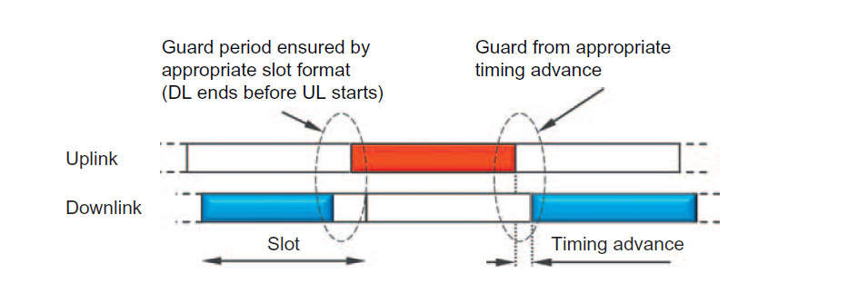
Time Division Duplex in 5G NR
TDD requires appropriate guard band to accomodate switching between uplink and downlink transmission
Important impact of uplink timing advance on guard interval duration
Figure: This figure is taken from E. Dahlman, S. Parkvall, J. Skoll: “5G NR-Next Generation Wireless Access Technology,” Academic Press (Elsevier), 2017 (Figure 7.16, page 123)

Slide 25
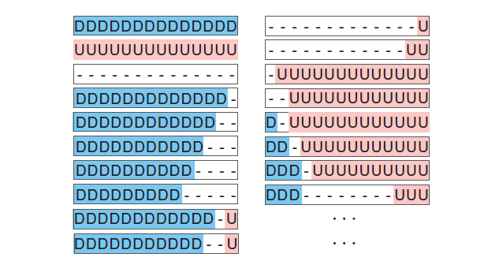
Slot Formats in 5G NR
Downlink and Flexible symbol: downlink transmissions can only occur in "downlink" or "flexible" symbols
Uplink symbol: uplink transmissions can only occur in "uplink" or "flexible" symbols. Guard period for TDD is taken from the flexible symbols.
Figure: This figure is taken from E. Dahlman, S. Parkvall, J. Skoll: “5G NR-Next Generation Wireless Access Technology,” Academic Press (Elsevier), 2017 (Figure 7.17, page 125)

Slide 26
Takeaway Message
We introduced main features of 5G New Radio standard
We presented transmission schemes and numerologies of 5G NR radio interface and emphasized its difference as compared to 4G LTE radio interface

Slide 27
Introduction to Modern Cellular Networks Part 9: 5G New Radio
Dejan Vukobratovic, Professor

