Slide 1
Introduction to Modern Cellular Networks Part 2: Spectrum Allocation for Mobile Cellular Standards
Dejan Vukobratovic, Professor

Slide 2
Outline of the Lecture
Short Intro to Wireless Communication Spectrum Usage
Spectrum Allocations in 4G and 5G

Slide 3
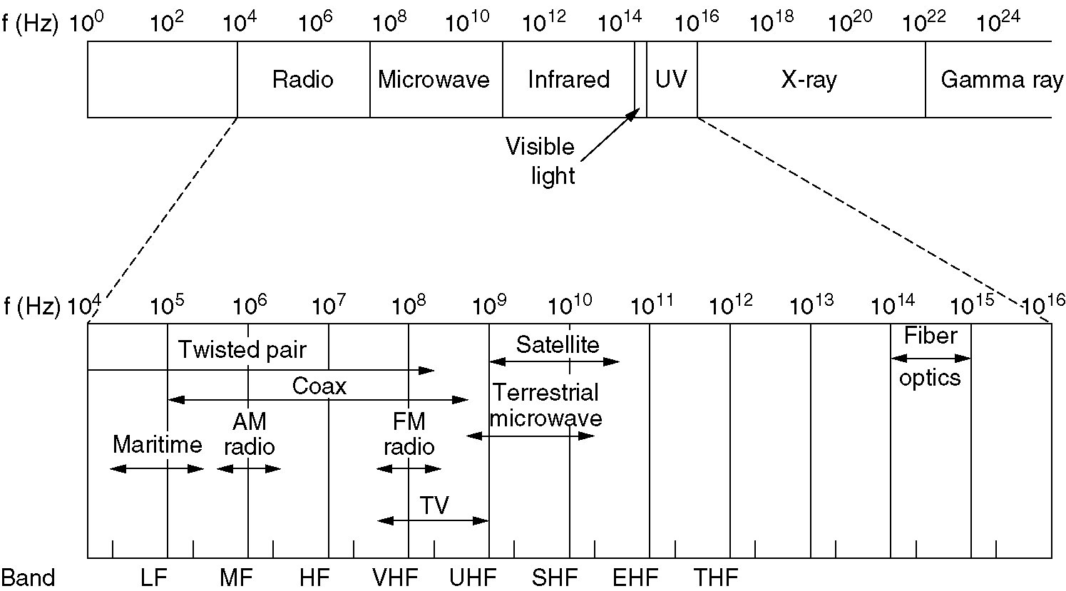
Spectrum Allocation in Wireless Communications

Slide 4
Radio waves (< 3 GHz)
Simple to generate
Depending on frequency, may traverse long distances
Penetrate the walls
Usually omni-directionally transmitted
Their features mainly depend on their frequency
At lower f they easily pass the walls – power decay with the power of distance;
At higher f they increasingly tend to become directional and reflect of obstacles, while the problem of absorption also becomes amplified
At all frequencies they are prone to interference
Spectrum is allocated by regulatory bodies so that usage of any defined radio channel requires a license (except ISM band)

Slide 5
Micro waves (3 – 30 GHz)
Radio waves up to 3 GHz are suitable for most terrestrial wireless communications. However, two major problems arise:
These bands are today largely fully occupied around the world
It is very hard to allocate broadband wireless channels (bandwidth of 100 MHz or more) in this spectral domain
Many terrestrial communication systems move to higher bands to search for available wideband channels
First such band is micro-wave band

Slide 6
Micro waves (3 – 30 GHz)
Micro-waves are traditionally used in:
Satellite communications
Directed high-throughput microwave links
They are usually generated using directed antennas and may traverse the path in a straight line
They are mainly reflected/absorbed by obstacles
Used to provide core network links where fiber is not possible
Common as backhaul links for cellular network base stations in rural areas
The band 26-28 GHz allocated for 5G mmWave in Europe

Slide 7
Millimeter waves (30 – 300 GHz)
mmWaves becoming popular for 5G around the world
3GPP standards define 5G mmWave channels up to 60 GHz
In some countries (S. Korea) bands around 90 GHz are used
They provide allocation of very large bandwidth channels (800 MHz)
Usually paired with Massive MIMO technology
Introduce formidable technical challenges to design baseband processing and RF modules for 5G mmWave systems

Slide 8
Licence-Free Bands
ISM (Industry, Scientific, Medical) is used for licence-excempt operation around the world
Allocation mostly overlaps world-wide
Used in popular IEEE technologies (Bluetooth, Wi-Fi, LR-PAN) and wide-area IoT technologies (LP-WAN such as LoRa and SigFox)

Slide 9
Spectrum Usage in Mobile Cellular Networks
Mobile cellular technologies rely on licenced spectrum bands
Pro: Reduces interference and provides guarantee of service quality
Con: Licence fee’s are extremely costly for mobile operator
Cellular deployment traditionally targets two spectrum domains
Sub 1 GHz frequencies for rural coverage to reduce the cost of rural infrastructure (usually bands between 700-900 MHz)
1-6 GHz frequencies for urban coverage where sufficiently wide band channels can be allocated for 3G/4G/5G data services
In 5G, hotspot indoor/outdoor cells will target usage of mmWave bands with extremely high throughput requirements

Slide 10
Outline of the Lecture
Short Intro to Wireless Communication Spectrum Usage
Spectrum Allocations in 4G and 5G

Slide 11
Spectrum Allocation in Cellular Systems
Historically, 1G and 2G spectra focused on 800-900 MHz band
With the rollout of 3G, focus moved to 2 GHz band
With 3G and 4G evolution, new bands are added, which now span the region between 450 MHz and 6 GHz
Introduction of 5G and high requirements of eMBB service push the spectrum usage to above 6 GHz bands
mmWave bands (26 GHz, 60 GHz, 90 GHz) are being allocated worldwide for 5G services but also for the latest Wi-Fi standards (45 and 60 GHz)

Slide 12
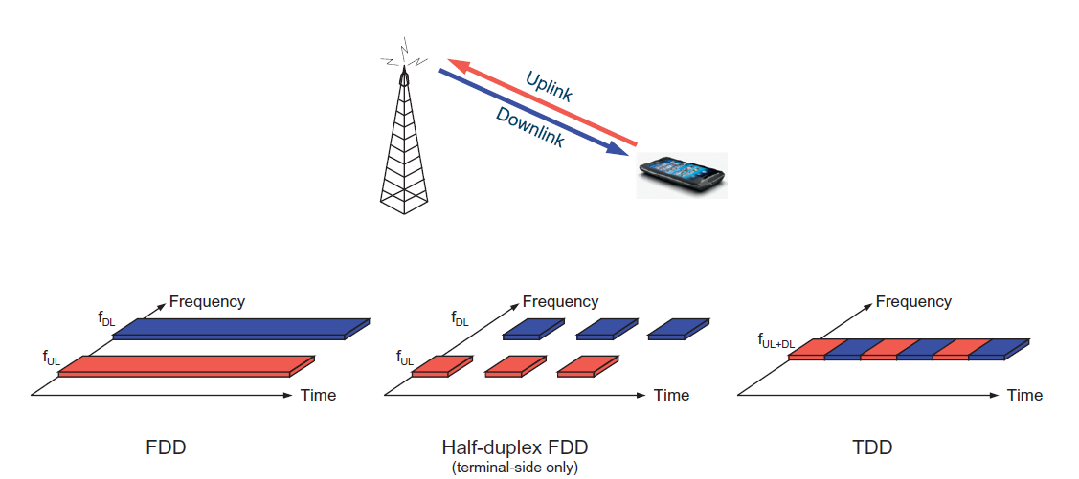
Paired/Unpaired Spectrum Bands
Paired Spectral Bands: Separate frequency channels are allocated for Downlink and Uplink system operation
Unpaired Spectral Band: Single frequency channel is allocated for both Downlink and Uplink system operation

Slide 13
Spectrum Allocation in 4G LTE
ITU-R responsible for spectrum allocation
Further refined by national policies
4G LTE Spectra Characteristics:
Paired and Unpaired Bands
Some bands come in fully separated Uplink (UL) / Downlink (DL) pairs suitable for Frequency Division Duplexing (FDD), while others come as single band suitable for Time Division Duplexing (TDD) where UL and DL interchange in time
Sub 1GHz and Above 1GHz Bands
Sub 1GHz bands are suitable for rural coverage with minimum number of macro- cellular sites, while above 1GHz bands are suitable for dense urban coverage

Slide 14
Spectrum Allocation in 4G LTE
4G LTE Channels are allocated for up to 20 MHz channels
Carrier Aggregation: Wider channels are obtained by aggregating several channels into wider composite channel
Constraints imposed by regulatory bodies may differ between different frequency bands
Allowed maximum transmission power
Requirements/limits on out-of-band (OOB) emission
Rel. 8 3GPP (LTE) includes 19 bands for FDD and 9 for TDD
Next slides present these bands in tables and figures

Slide 15
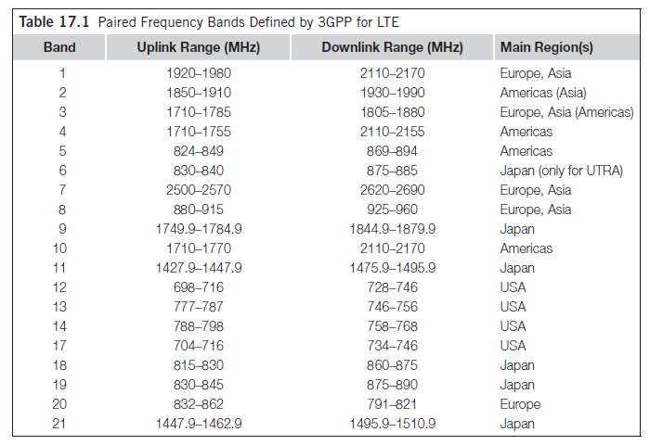
Paired 4G LTE Spectrum Bands
Figure: This figure is taken from E. Dahlman, S. Parkvall, J. Skoll: “4G LTE/LTE-Advanced for Mobile Broadband,” Academic Press (Elsevier), 2018 (Table 17.1, page 349)

Slide 16
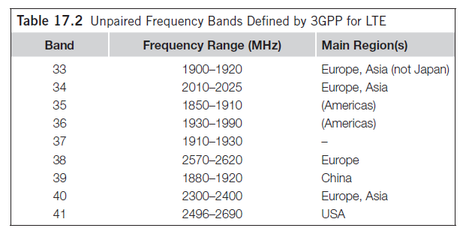
Unpaired 4G LTE Spectrum Bands
Figure: This figure is taken from E. Dahlman, S. Parkvall, J. Skoll: “4G LTE/LTE-Advanced for Mobile Broadband,” Academic Press (Elsevier), 2018 (Table 17.2, page 349)

Slide 17
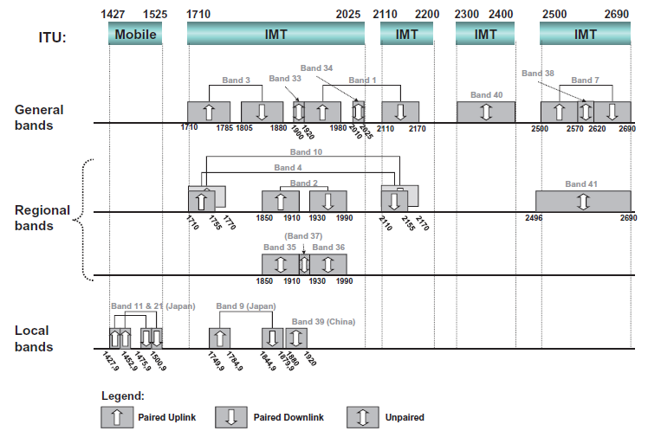
Above 1GHz 4G LTE Spectrum Bands
Figure: This figure is taken from E. Dahlman, S. Parkvall, J. Skoll: “4G LTE/LTE-Advanced for Mobile Broadband,” Academic Press (Elsevier), 2018 (Figure 17.1, page 350)

Slide 18
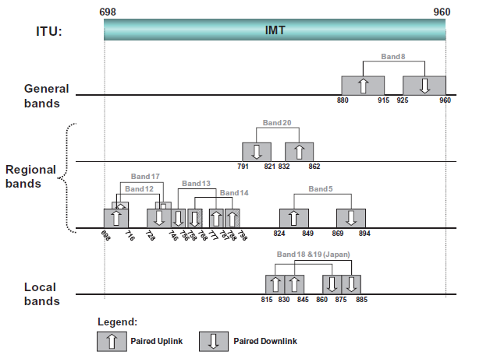
Sub-1GHz 4G LTE Spectrum Bands
Figure: This figure is taken from E. Dahlman, S. Parkvall, J. Skoll: “4G LTE/LTE-Advanced for Mobile Broadband,” Academic Press (Elsevier), 2018 (Figure 17.2, page 351)

Slide 19
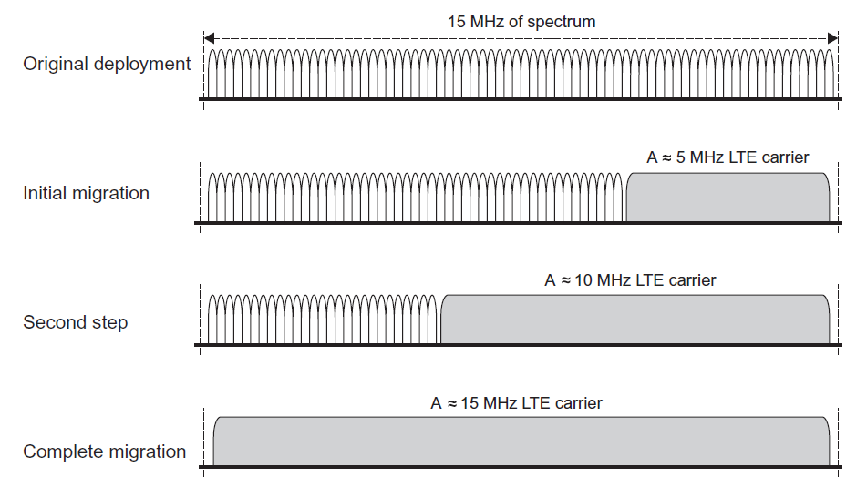
Flexible Bandwidth Allocation in 4G LTE
Gradual spectrum migration from GSM to LTE (GSM refarming)
Figure: This figure is taken from E. Dahlman, S. Parkvall, J. Skoll: “4G LTE/LTE-Advanced for Mobile Broadband,” Academic Press (Elsevier), 2018 (Figure 17.3, page 353)

Slide 20
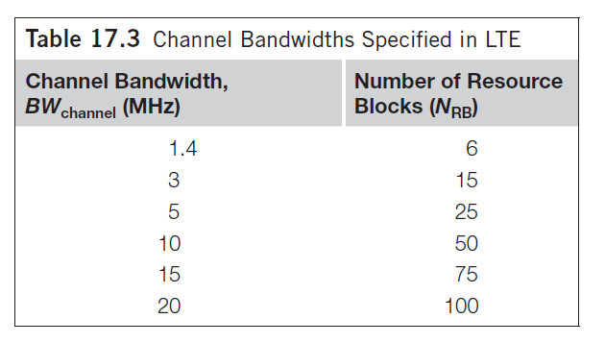
Flexible Bandwidth Allocation in 4G LTE
Spectrum flexibility of LTE is achieved via six different LTE channel bandwidth allocations ranging from 1.4 MHz to 20 MHz
Figure: This figure is taken from E. Dahlman, S. Parkvall, J. Skoll: “4G LTE/LTE-Advanced for Mobile Broadband,” Academic Press (Elsevier), 2018 (Table 17.3, page 354)

Slide 21
Flexible Bandwidth Allocation in 4G LTE-Advanced
Starting from Release 10 (LTE-Advanced), it is possible to aggregate several bands into a single 4G LTE signal using Carrier Aggregation
Figure: This figure is taken from E. Dahlman, S. Parkvall, J. Skoll: “4G LTE/LTE-Advanced for Mobile Broadband,” Academic Press (Elsevier), 2018 (Figure 7.4, page 104)

Slide 22
Spectrum Allocation in 5G NR
5G NR Channels are defined at ITU WRC 2015 conference
On top of previous 3G/4G bands, new spectrum bands are:
470 – 698 MHz
694 – 790 MHz
1427 – 1518 MHz (L Band)
3300 – 3400 MHz (Africa)
3400 – 3700 MHz (C Band)
4800 – 4990 MHz (Asia)
Bands above 3.3 GHz suitable for eMBB using massive MIMO

Slide 23
mmWave Spectrum Allocation in 5G NR
ITU WRC 2015 initiated and at WRC 2019 adopted a new set of spectrum bands for mmWave
Among the considered bands, the current range between 24.25 GHz and 52.6 GHz is adopted for use in 5G NR
Figure: This figure is taken from E. Dahlman, S. Parkvall, J. Skoll: “5G NR: The next generation wireless access technology,” Academic Press (Elsevier), 2018 (Figure 3.1, page 30)

Slide 24
Spectrum Allocation in 5G NR
Low-Frequency bands: Highest interest on 600 and 700 MHz bands (n71 and n28 bands)
Maximum 20 MHz channel allocation is expected in this range
Medium-Frequency bands: In 3-6 GHz range, highest interest is in the range 3.3 – 4.2 GHz (n77 and n78 bands)
Maximum 100 MHz channel allocation expected
Higher bands between 4.4 – 5 GHz of interest in China and Japan
High-Frequency Bands: Above 24 GHz bands, 24.25 – 29.5 GHz (n257 and n258 bands) suitable for extremely high throughput hotspot coverage, with channel bandwidths of up to 400 MHz
Figure: This figure is taken from E. Dahlman, S. Parkvall, J. Skoll: “5G NR: The next generation wireless access technology,” Academic Press (Elsevier), 2018 (Figure 3.1, page 30)

Slide 25
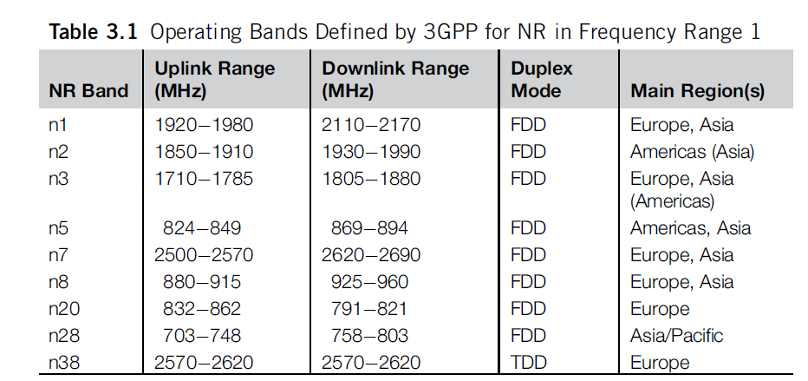
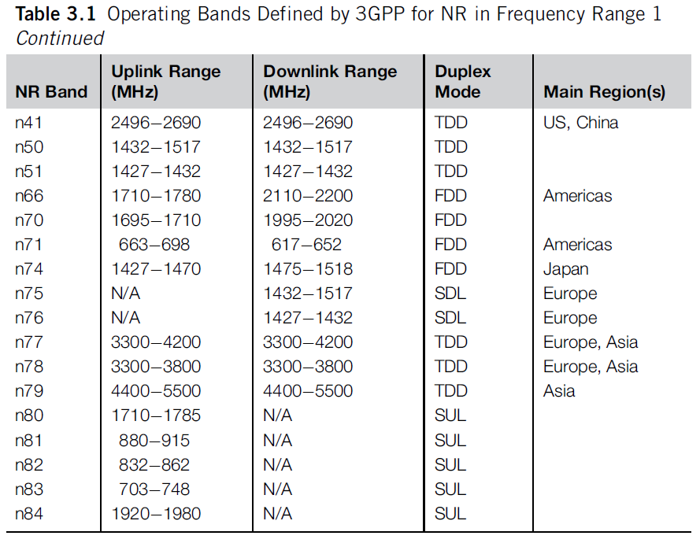
Spectrum Allocation in 5G NR - FR 1 and FR 2
Figure: Tables 3.1 and 3.2 are taken from E. Dahlman, S. Parkvall, J. Skoll: “5G NR: The next generation wireless access technology,” Academic Press (Elsevier), 2018 (pages 33-34)

Slide 26
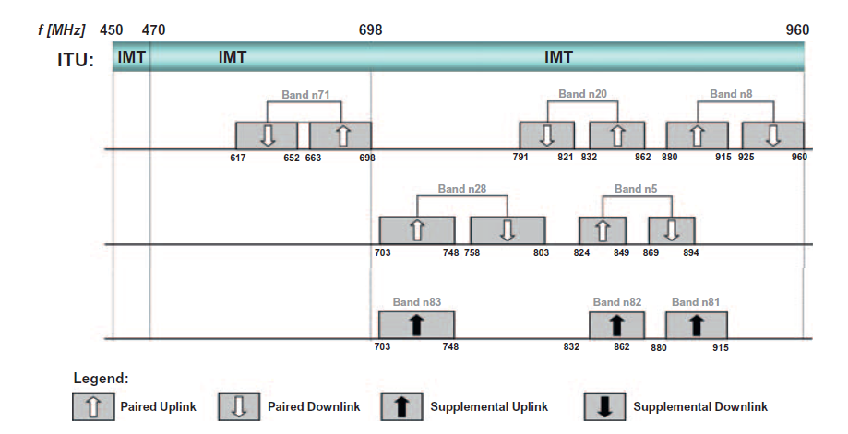
Sub-1GHz 5G NR Spectrum Bands
Figure: This figure is taken from E. Dahlman, S. Parkvall, J. Skoll: “5G NR: The next generation wireless access technology,” Academic Press (Elsevier), 2018 (Figure 3.2, page 34)

Slide 27
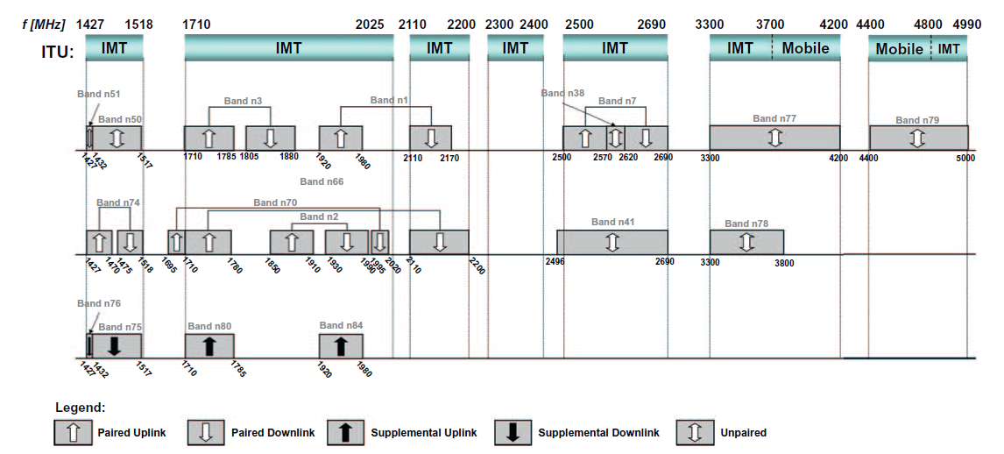
1 – 6 GHz 5G NR Spectrum Bands
Figure: This figure is taken from E. Dahlman, S. Parkvall, J. Skoll: “5G NR: The next generation wireless access technology,” Academic Press (Elsevier), 2018 (Figure 3.3, page 35)

Slide 28
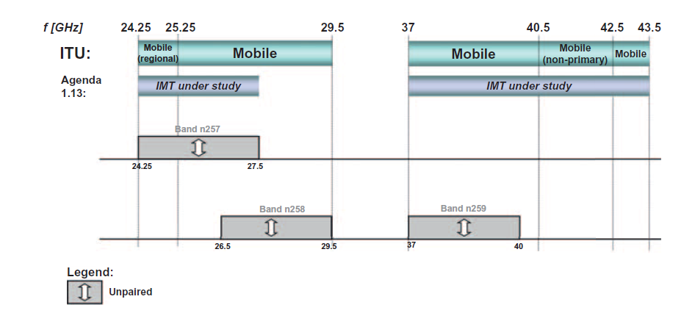
Above 6 GHz 5G NR Spectrum Bands
Figure: This figure is taken from E. Dahlman, S. Parkvall, J. Skoll: “5G NR: The next generation wireless access technology,” Academic Press (Elsevier), 2018 (Figure 3.4, page 36)

Slide 29
Takeaway Message
We explained the basics of Radio Frequency signal propagation across different frequency ranges of the RF spectrum, indicating pros and cons of different RF spectrum ranges
We provided in-depth coverage of RF spectrum allocation in 4G and 5G networks

Slide 30
Further Reading
5G Book, Chapter 3
4G Book, Chapter 17

Slide 31
Introduction to Modern Cellular Networks Part 2: Spectrum Allocation for Mobile Cellular Standards
Dejan Vukobratovic, Professor

