Slide 1
Introduction to Modern Cellular Networks Part 10: Advanced topics in 5G and Beyond 5G
Dejan Vukobratovic, Professor

Slide 2
Outline of the Lecture
Massive MIMO Technology
MIMO Beam Management
The Road Towards 6G

Slide 3
Multi-Antenna Techniques
Use multiple antennas at the transmitter and/or receiver in combination with advanced signal processing techniques order to improve system performance:
Improved System Capacity: More users per cell
Improved Coverage: Possibility for larger cells
Improved Service Provisioning: Higher per-user data rates

Slide 4
Distance and Correlation Between Antennas
In MIMO systems, distance between antenna elements affect the correlation of the radio-channel fading
Low correlation: Antennas are physically distanced far apart
High correlation: Antennas are physically close to each other
Different antenna configurations are suitable for different MIMO configurations: diversity, beamforming, spatial multiplexing
For macro-cellular BS, distance of 10λ is sufficient for low correlation
For mobile terminals, distance of 0.5λ is needed for low correlation
This distance is related to arrival angular spread of multi-path components which is typically much larger for UEs then eNBs

Slide 5
MIMO Techniques
MIMO transmission is a key component of NR, especially at higher frequencies
Diversity: Multiple antennas at the transmitter and/or receiver can provide diversity against fading
Channels experienced by different antennas are at least partly uncorrelated, either due to sufficient inter-antenna distance or different polarization between the antennas
Beamforming: by careful adjusting the phase and amplitude of each antenna element, multiple antennas at the transmitter side can provide directivity
Directivity increases data rate/range due to higher power reaching the target receiver
Directivity reduces the interference to other links, improving the spectrum efficiency
Spatial Multiplexing: multiple antennas at both the transmitter and the receiver may enable spatial multiplexing, that is, transmission of multiple “layers” in parallel using the same time/frequency resources

Slide 6
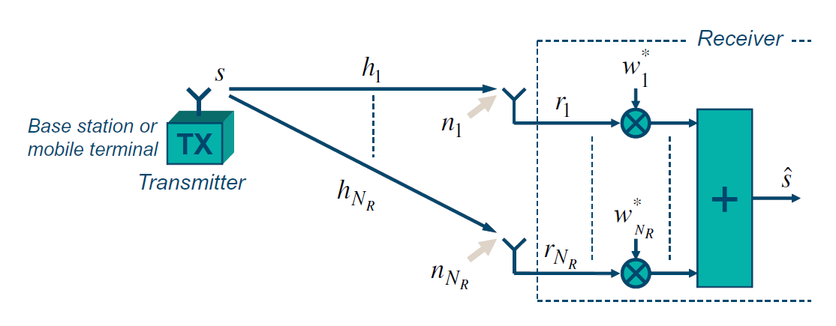
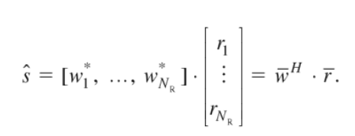
Receiver Diversity
Linear Receive Antenna Combining
Multiple receivers receive the same signal
Optimal receiver: Maximum Ratio Combining (MRC)
MRC – Main ideas
Phase rotate signals from different antennas to compensate for channel phases and ensure coherent combining
Weights the signals in proportion to channel gains
Figure: This figure is taken from E. Dahlman, S. Parkvall, J. Skoll: “4G LTE/LTE-Advanced for Mobile Broadband,” Academic Press (Elsevier), 2011 (Figure 5.2, page 61)

Slide 7
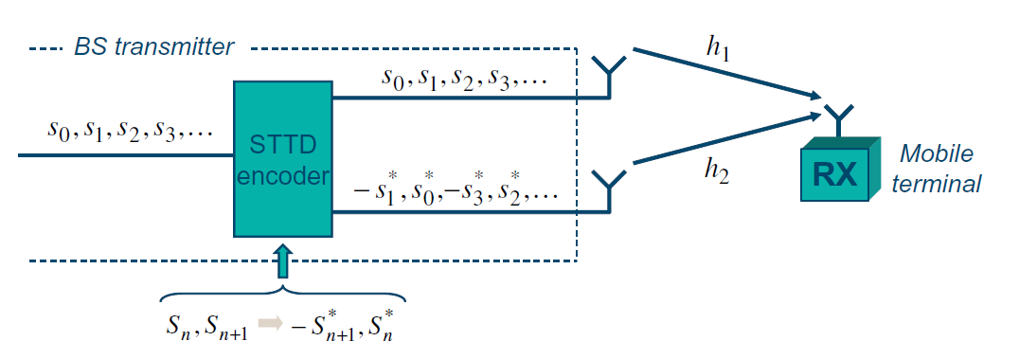
Transmitter Diversity
Transmit Antenna Precoding
Send multiple versions of a signal to ensure better reception
Popular Approach: Space-Time Block Coding (STBC):
STBC – Main Idea
Special case is 2x2 Alamouti Scheme
Receiver obtains sent symbols by applying weight matrix H⁻¹
Both Tx and Rx diversity improve data rate by improving received signal quality (SNR)
Figure: This figure is taken from E. Dahlman, S. Parkvall, J. Skoll: “4G LTE/LTE-Advanced for Mobile Broadband,” Academic Press (Elsevier), 2011 (Figure 5.9, page 67)

Slide 8
Spatial Multiplexing MIMO
Spatial multiplexing
Increasing data rate by sending multiple parallel data streams
Spatial Mux
In the case of MIMO it is, under certain conditions, possible to create up to N_{L} = min{N_{T}, N_{R}} parallel “channels”
Figure: This figure is taken from E. Dahlman, S. Parkvall, J. Skoll: “4G LTE/LTE-Advanced for Mobile Broadband,” Academic Press (Elsevier), 2011 (Figure 5.14 and 5.15, page 71)

Slide 9
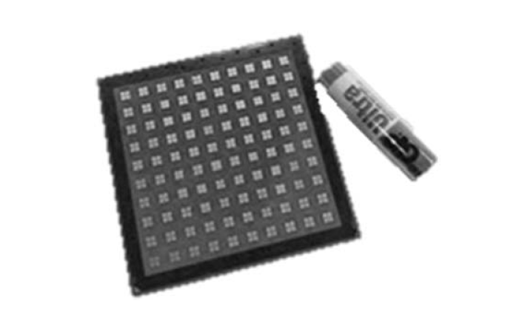
Massive MIMO
Example of antenna panel consisting of 100 dual polarized antenna elements @28 GHz
The direction of the beam can be adjusted by separately adjusting the phase of the signals applied to each antenna element (at both Tx/Rx)
General model of MIMO transmission mapping N_{L} layers to N_{T} antennas
Applies to most of the MIMO scenarios but depends on implementation
Figure: This figure is taken from E. Dahlman, S. Parkvall, J. Skoll: “5G NR-Next Generation Wireless Access Technology,” Academic Press (Elsevier), 2017 (Figure 11.1 and 11.2, page 227)

Slide 10
MIMO Techniques
Where within the overall physical transmitter chain the multi-antenna processing (the matrix W) is applied?
Digital multi-antenna processing is of high complexity due to large number of DAC in densely packed and close spaced antennas
Simple analog phase shifting is least expensive - beamforming
Figure: This figure is taken from E. Dahlman, S. Parkvall, J. Skoll: “5G NR-Next Generation Wireless Access Technology,” Academic Press (Elsevier), 2017 (Figure 11.3, page 228)

Slide 11
MIMO Beamforming
Analog multi-antenna processing for beamforming
Not very flexible
For example, can be only applied across the whole carrier
Only time-domain beamforming in multiple directions is possible
For lower frequency bands and smaller number of antenna elements, digital multi-antenna processing is more flexible
Frequency-domain beamforming
Figure: This figure is taken from E. Dahlman, S. Parkvall, J. Skoll: “5G NR-Next Generation Wireless Access Technology,” Academic Press (Elsevier), 2017 (Figure 11.4, page 228, Figure 11.5 and 11.6, page 229)

Slide 12
Outline of the Lecture
Massive MIMO Technology
MIMO Beam Management
The Road Towards 6G

Slide 13
Beam Management
Beam management establishes and retains a suitable beam pair, that is, a transmitter-side beam direction and a corresponding receiver-side beam direction that jointly provide good connectivity
The best beam pair may not necessarily correspond to transmitter and receiver beams that are physically pointing directly towards each other
Due to obstacles in the environment, such a “direct” path between the transmitter and receiver may be blocked and a reflected path may provide better connectivity
Figure: This figure is taken from E. Dahlman, S. Parkvall, J. Skoll: “5G NR-Next Generation Wireless Access Technology,” Academic Press (Elsevier), 2017 (Figure 12.1, page 242)

Slide 14
Beam Management
Beam correspondence usually, a suitable transmitter/receiver beam pair for the downlink transmission direction will also be a suitable beam pair for the uplink transmission direction and vice versa
In general, beam management can be divided into different parts:
Initial beam establishment
Beam adjustment compensates for movements and rotations of the mobile device, but also for gradual changes in the environment
Beam recovery handles the situation when rapid changes in the environment disrupt the current beam pair.

Slide 15
Initial Beam Establishment
Initial beam establishment includes the procedures and functions by which a beam pair is initially established in the downlink and uplink transmission directions, for example, when a connection is established
Initial beam pair is established during random access procedure
During initial cell search a device will acquire a so called SS block transmitted from a cell, with the possibility for multiple SS blocks being transmitted in sequence within different downlink beams
When communication continues after connection set up the device can assume that network transmissions to the device will be done using the same transmitter beam as used for the acquired SS block

Slide 16
Beam Adjustment
Initial beam establishment: Once an initial beam pair has been established, there is a need to regularly reevaluate the selection of transmitter-side and receiver-side beam directions due to movements and rotations of the device
Beam adjustment includes refining the beam shape, e.g. making the beam more narrow compared to a wider beam used for initial beam establishment
Beam adjustment can be divided into two separate procedures:
Reevaluation and possible adjustment of the transmitter-side beam direction given the current receiver-side beam direction
Reevaluation and possible adjustment of the receiver-side beam direction given the current transmitter-side beam direction

Slide 17
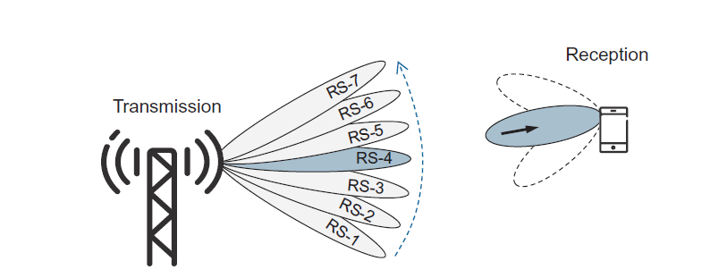
DL Transmitter-side Beam Adjustment
Downlink transmitter-side beam adjustment aims at refining the network transmit beam, given the receiver beam currently used at the device side
Device measures a set of reference signals and feeds back the report
For analog BF, this is done sequentially as part of Beam Sweeping
Figure: This figure is taken from E. Dahlman, S. Parkvall, J. Skoll: “5G NR-Next Generation Wireless Access Technology,” Academic Press (Elsevier), 2017 (Figure 12.2, page 244)

Slide 18
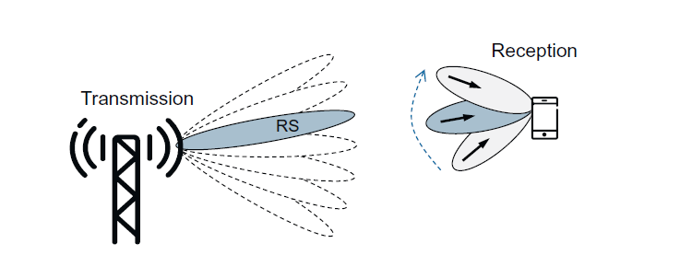
DL Receiver-side Beam Adjustment
Receiver-side beam adjustment aims at finding the best receive beam, given the current transmit beam
Downlink receiver-side beam adjustment can be based on similar report configurations as for transmitter-side beam adjustment
The receiver-side beam adjustment is done internally within the device, there is no report quantity associated with receiver-side beam adjustment
Figure: This figure is taken from E. Dahlman, S. Parkvall, J. Skoll: “5G NR-Next Generation Wireless Access Technology,” Academic Press (Elsevier), 2017 (Figure 12.3, page 245)

Slide 19
Beam Recovery
Movements in the environment or other events may lead to a currently established beam pair being rapidly blocked without sufficient time for the regular beam adjustment to adapt
NR specification includes specific procedures to handle such beam-failure events, also referred to as beam (failure) recovery
In general, beam failure/recovery consists of the following steps:
Beam-failure detection: the device detecting that a beam failure has occurred
Candidate-beam identification: the device trying to identify a new beam pair
Recovery-request transmission: the device transmits a beam-recovery request
Network response to the beam-recovery request.

Slide 20
Outline of the Lecture
Massive MIMO Technology
MIMO Beam Management
The Road Towards 6G

Slide 21
The most promising concepts for Beyond 5G
Non-Terrestrial Networks (NTN)
Intelligent Reflective Surfaces (IRS)
Terahertz (THz) Communications
Open Radio Access Network (O-RAN)
Machine Learning and Artificial Intelligence Integration
Integrated Communications and Sensing (ISC)

Slide 22
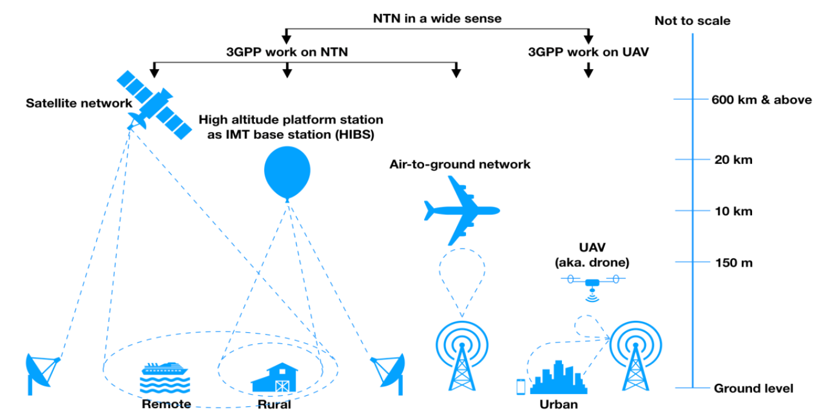
Non-Terrestrial Networks (NTN)
3GPP invests significant effort in 5G NTN
Low Earth Orbit (LEO) Constellations
Effective solution for backhaul connectivity for base stations deployed in deep rural areas beyond traditional backbone infrastructure
NB-IoT over LEO – connect IoT devices globally
UAV-based Cellular Connectivity
Use drones as auxiliary base stations
Address both coverage and capacity issues
Additional infrastructure at flash crowd events
Lin, X., Rommer, S., Euler, S., Yavuz, E.A. and Karlsson, R.S., 2021. 5G from space: An overview of 3GPP non-terrestrial networks. IEEE Communications Standards Magazine.

Slide 23
Intelligent Reflective Surfaces (IRS)
With transition to higher bands such as mmWave, propagation is increasingly challenged by obstacles including human body
Until now, active elements of communication systems were Tx and Rx parts, while the channel was considered passive
Can we make channel (i.e., environment) active?
IRS are indoor or outdoor panels made of metamaterials capable of being remotely controlled for different electromagnetic properties (wave reflection, refraction, absorption, etc.)
The challenge is to control IRS to improve Tx-Rx channel

Slide 24
Terahertz (THz) Communications
Moving to mmWave, more precisely, the range between 30-100 GHz, is not the end of attempts to use higher frequency bands
Recent research addresses development of antennas, Tx and Rx solutions for above 100 GHz bands
Such bands further increase opportunities for massive antenna system integration, higher bandwidth allocations, etc., however, the channel propagation challenges further increase
Ultimately, visible light communications (VLC) are becoming mature technology candidate to be integrated for indoor 5G use cases

Slide 25
Open Radio Access Network (O-RAN)
5G Core Network has been virtualized and softwarized in recent years – all of the 5G CN elements are running as software elements in general purpose servers
Softwarization and virtualization is gradually moving into RAN
Goal: Make RAN interfaces open and connect RAN elements of different vendors, whether they are built in software or hardware
First step: Base station disaggregation into Radio Unit (RU), Distributed Units (DU) and Central Unit (CU)
DU and CU is software running in edge cloud centres

Slide 26
ML and AI in Beyond 5G
5G Core Network is introducing various data analytics functions to support intelligent services in core network
The trend is gradually moving to RAN network and integration of ML and AI concepts in RAN
O-RAN leads these efforts through introduction of Near Real-Time and Non-Real-Time Radio Interface Controllers (RIC)
Non-RT RIC and Near-RT RIC will support applications that would exploit ML and AI methods to improve resource management and control

Slide 27
Integrated Communications and Sensing (ISC)
Extremely wideband channels (400 MHz in 5G mmWave) allow for increased resolution of 5G signals
Suitable signal processing methods could exploit 5G signals to detect various features of the environment
How to enable 5G to integrate radar-like sensing is a novel challenge that could improve wireless intelligence
5G ISC could improve device localization, environmental awareness and provide data for ML&AI training, model design and inference

Slide 28
Takeaway Message
We presented basic multi-antenna techniques in 5G NR
We described the beam management procedures in 5G NR
We peeked into the near future beyond 5G

Slide 29
Introduction to Modern Cellular Networks Part 10: Advanced topics in 5G and Beyond 5G
Dejan Vukobratovic, Professor

