Slide 1
Introduction to Modern Cellular Networks Part 4: 5G NR Network Architecture and Radio Access Network (RAN) Protocols
Dejan Vukobratovic, Professor

Slide 2
Outline of the Lecture
Overview of 3GPP NR System Architecture
NR Radio Access Network (RAN) Protocols

Slide 3
Preliminaries
4G LTE is based on split architecture: RAN + EPC
The same principle is preserved in 5G NR: 5G Core + 5G RAN
5G RAN can be connected to 4G LTE EPC
Non-Stand-Alone (NSA) 5G NR (first stage of 5G deployment)
5G RAN connected to 5G Core will represent Stand-Alone (SA) deployment
4G LTE will be also compatible with 5G Core
This is in contrast with transition from 3G to 4G where RAN/Core networks of different technologies were not compatible

Slide 4
5G Core Network
Three major features of 5G Core:
Service-based architecture
Architectures focuses on services and functionalities, not on nodes
Due to virtualization of core network functions
Support for network slicing
Slice is a logical network deployed on a same physical core and RAN and providing specific services (e.g., two slices could be eMBB and URLLC)
Control-plane/User-plane split
Independent deployment and management of control and user plane functionality

Slide 5
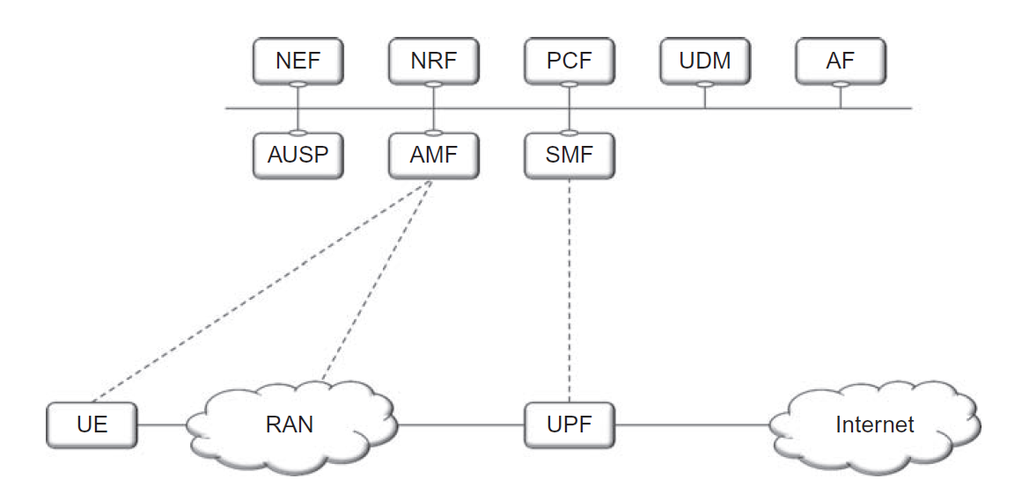
High-Level 5G Core Network Architecture
Figures: The figure is taken from E. Dahlman, S. Parkvall, J. Skoll: “5G NR: The Next Generation Wireless Access Technology,” Academic Press (Elsevier), 2017 (Figures 6.1, page 74)

Slide 6
User Plane Function (UPF)
User Plane Function
Gateway between RAN and external networks (Internet)
Packet routing and forwarding
QoS handling
Packet inspection and filtering
Traffic measurements
Anchor point for intra-RAT handover
Figures: The figure is taken from E. Dahlman, S. Parkvall, J. Skoll: “5G NR: The Next Generation Wireless Access Technology,” Academic Press (Elsevier), 2017 (Figures 6.1, page 74)

Slide 7
Session Management Function (SMF)
Session Management Function
Handles IP address allocation to User Equipment
Control of policy enforcement
General session management
Figures: The figure is taken from E. Dahlman, S. Parkvall, J. Skoll: “5G NR: The Next Generation Wireless Access Technology,” Academic Press (Elsevier), 2017 (Figures 6.1, page 74)

Slide 8
Access and Mobility Management Function (AMF)
Access and Mobility Management Function
Control Signaling between the Core and the device
User data security
Authentication
Idle-state mobility
Functionality operating between AMF and device – Non-Access Stratum (NAS)
Figures: The figure is taken from E. Dahlman, S. Parkvall, J. Skoll: “5G NR: The Next Generation Wireless Access Technology,” Academic Press (Elsevier), 2017 (Figures 6.1, page 74)

Slide 9
Various Network Management Functions
Policy Control Function (PCF)
Definition of Policy Rules
Unified Data Management (UDM)
Authentication Credentials and access authentication
Network Exposure Function (NEF)
NR Repository Function (NRF)
Application Function (AF)
Figures: The figure is taken from E. Dahlman, S. Parkvall, J. Skoll: “5G NR: The Next Generation Wireless Access Technology,” Academic Press (Elsevier), 2017 (Figures 6.1, page 74)

Slide 10
5G Core Network Function Virtualization
5G Core Network Functions can be implemented as:
A single physical node
A set of distributed physical nodes
Virtualized in a centralized cloud platform
Virtualized and distributed across edge/fog/cloud
Mobile operators are transitioning to cloud-based virtualized CN
All CN functions are software-based and virtualized
Flexible deployment and scaling (adding additional virtual machines)

Slide 11
4G and 5G Interworking
To allow early 5G deployment, NR RAN can be supported by 4G EPC
Non-Stand-Alone deployment (Option 3)
All control-related functions are handled by LTE, NR is used for user-data
With 5G Core deployment, NR RAN can directly connect to 5GC
Stand-Alone operation (Option 2)
Figures: The figure is taken from E. Dahlman, S. Parkvall, J. Skoll: “5G NR: The Next Generation Wireless Access Technology,” Academic Press (Elsevier), 2017 (Figures 6.2, page 75)

Slide 12
Outline of the Lecture
Overview of 3GPP NR System Architecture
NR Radio Access Network (RAN) Protocols

Slide 13
5G Radio Access Network Elements
5G Radio Access Network contains two types of base stations:
gNB – serving NR devices using both NR user- and control-plane
ng-eNB – serving LTE devices using LTE user- and control-plane
Next-Generation RAN (NG-RAN): 5G RAN consists of ng-eNB to serve LTE devices and gNB to serve NR devices
Flat architecture with ng-eNB/gNB elements

Slide 14
5G RAN gNB Element
gNB Element
All radio-related functions in one or several cells
Radio resource management, admission control, connection establishment
Routing of user data to UPF and control information to AMF
QoS management per packet flow
gNB is a logical node and not a physical implementation
Standard three-sector macro-cellular site
Baseband processing unit (BBU) with a number of remote radio heads (RRH)
Disagregated gNB based on Open-RAN (O-RAN) specifications

Slide 15
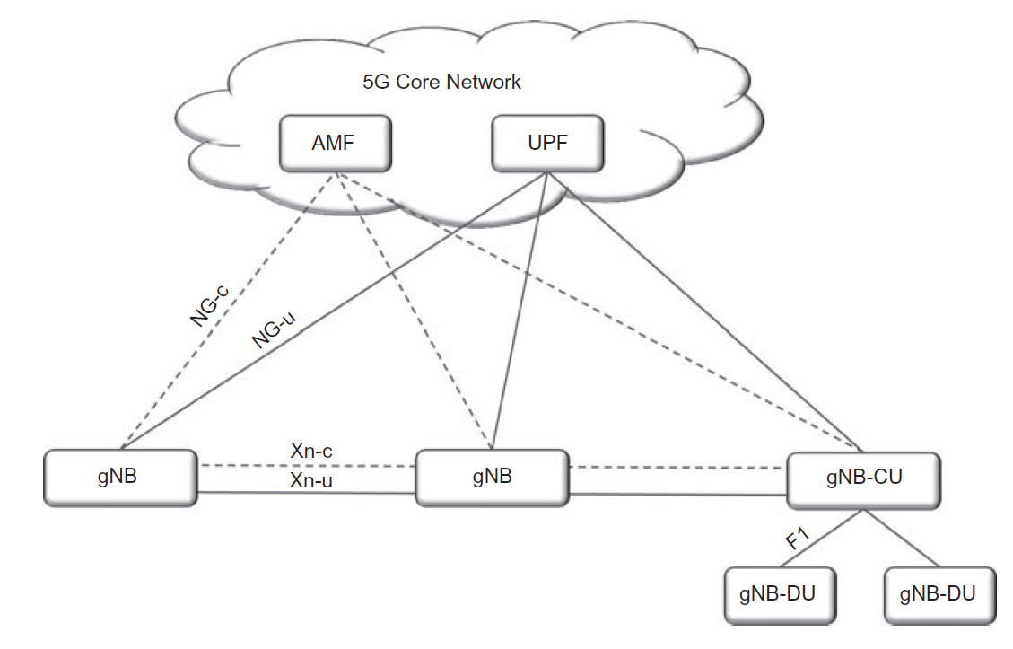
5G RAN gNB Splitting
NG Interface
Connects gNB to 5G Core
Separate user-plane (NG-u) and control-plane (NG-c)
One gNB can have multiple NG interfaces for load sharing and redundancy
Xn Interface
Similar to X2 in LTE
Active mode mobility
Dual-connectivity
Joint gNB signal processing
Figures: The figure is taken from E. Dahlman, S. Parkvall, J. Skoll: “5G NR: The Next Generation Wireless Access Technology,” Academic Press (Elsevier), 2017 (Figures 6.3, page 77)

Slide 16
5G RAN gNB Element
F1 Interface
Enables gNB Functional Split
gNB Central Unit (gNB-CU)
gNB Distributed Unit (gNB-DU)
gNB-CU: Higher layer protocols (SDAP, PDCP, RRC)
gNB-CU: Lower layer protocols (RLC, MAC, PHY)
Figures: The figure is taken from E. Dahlman, S. Parkvall, J. Skoll: “5G NR: The Next Generation Wireless Access Technology,” Academic Press (Elsevier), 2017 (Figures 6.3, page 77)

Slide 17
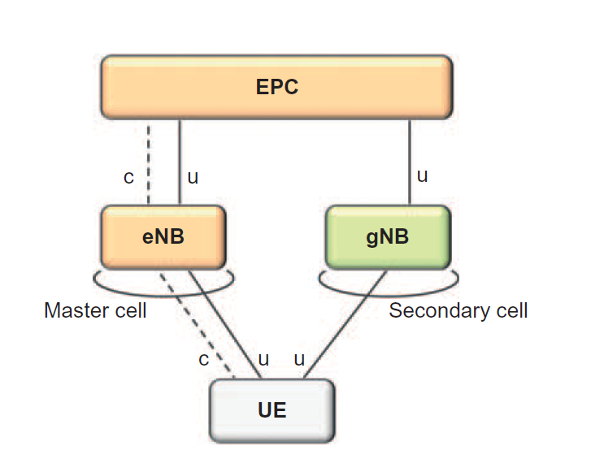
5G gNB Dual Connectivity
Dual Connectivity
Allowing the device (UE) to connect to multiple cells
Useful to increase aggregate data rate of the user
Useful also for Non-Stand-Alone (NSA) deployment (figure)
LTE master cell handles C-plane connection
NR secondary cell handles U-plane connection
Figures: The figure is taken from E. Dahlman, S. Parkvall, J. Skoll: “5G NR: The Next Generation Wireless Access Technology,” Academic Press (Elsevier), 2017 (Figures 6.4, page 78)

Slide 18
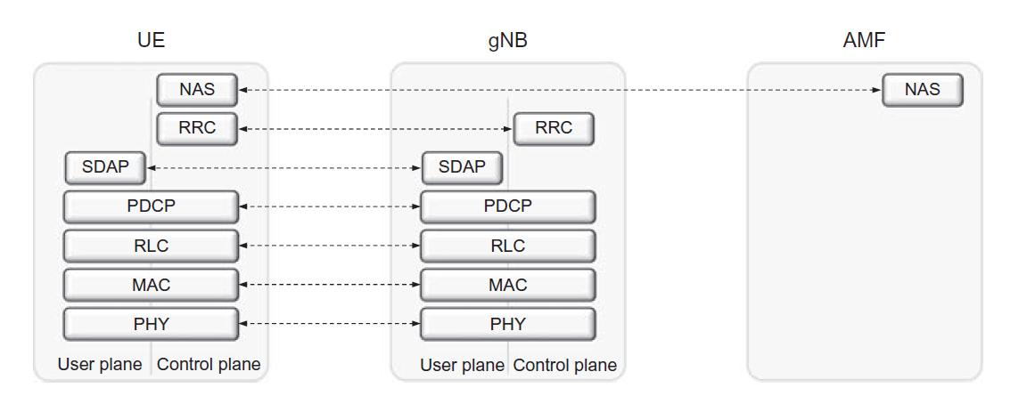
Radio Access Network Architecture
Figures: The figure is taken from E. Dahlman, S. Parkvall, J. Skoll: “5G NR: The Next Generation Wireless Access Technology,” Academic Press (Elsevier), 2017 (Figures 6.6, page 80)

Slide 19
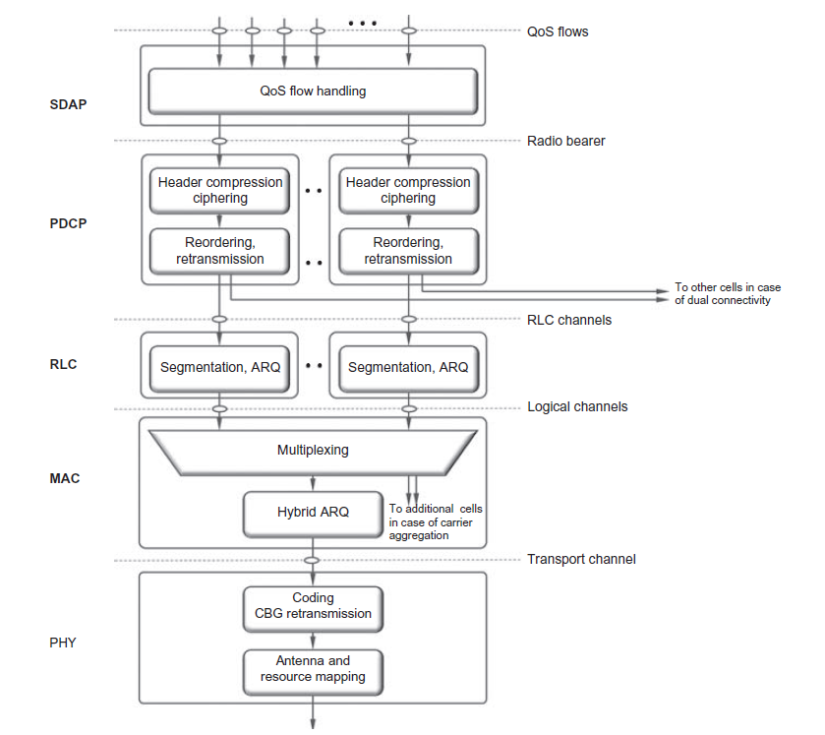
RAN Protocols
Similar to 4G LTE
Most notable difference is a new SDAP layer for QoS handling
SDAP is not used in case gNB is connected to EPC
Figure: The figure is taken from E. Dahlman, S. Parkvall, J. Skoll: “5G NR: The Next Generation Wireless Access Technology,” Academic Press (Elsevier), 2017 (Figures 6.7, page 81)

Slide 20
Service Data Application Protocol SDAP
New layer in 5G NR RAN
Maps QoS flows to Radio bearers according to their QoS requirements

Slide 21
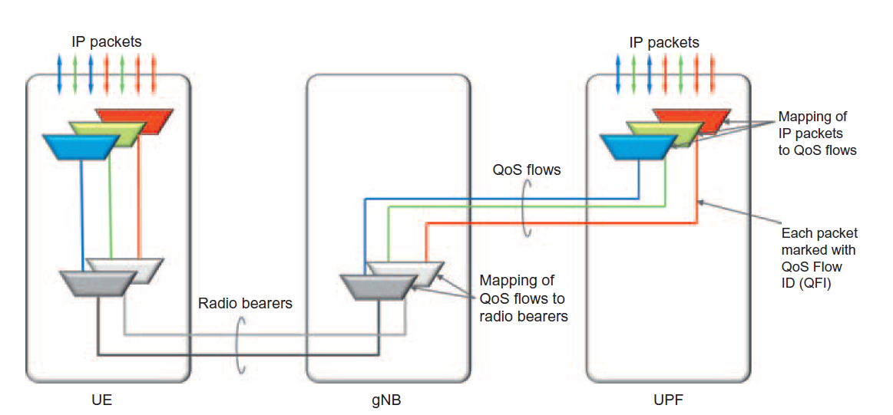
Service Data Application Protocol (SDAP)
Figures: The figure is taken from E. Dahlman, S. Parkvall, J. Skoll: “5G NR: The Next Generation Wireless Access Technology,” Academic Press (Elsevier), 2017 (Figures 6.5, page 79)

Slide 22
Packet Data Convergence Protocol PDCP
Performs IP header compression using ROHC (Robust Header Compression)
Data ciphering
Integrity check of control data packets
In-sequence delivery and duplicate removal (during handover)
One PDCP entity per radio bearer

Slide 23
Radio Link Control Protocol RLC
Segmentation to create variable size RLC PDUs based on scheduler decisions
Concatenation is removed due to delay
RLC retransmission using ARQ mechanism
Duplicate detection
Unlike LTE, NR does not support in-sequence delivery to PDCP to reduce delay
One RLC entity per radio bearer

Slide 24
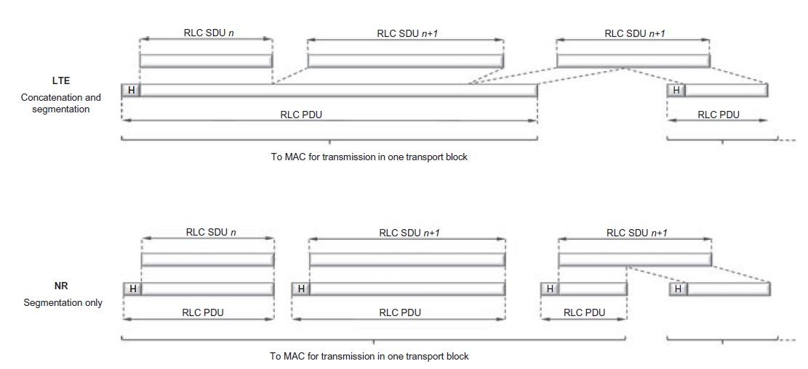
Radio Link Control Protocol (RLC)
Figures: The figure is taken from E. Dahlman, S. Parkvall, J. Skoll: “5G NR: The Next Generation Wireless Access Technology,” Academic Press (Elsevier), 2017 (Figures 6.10, page 85)

Slide 25
Medium Access Control Protocol MAC
Provides services to RLC in the form of logical channels
Performs multiplexing of logical channels
Uplink and downlink scheduling (located at eNB for both UL/DL)
Hybrid ARQ (HARQ) retransmissions
MAC frame size aligned to PHY transport block (TB) size which depends on PHY configuration
Minor changes in header format in 5G NR to allow for support for low-latency processing

Slide 26
Physical Layer Protocol PHY
Provides services to MAC layer in the form of physical channels
Error correction coding and decoding
Adaptive modulation and OFDM resource grid mapping
MIMO antenna system signal processing

Slide 27
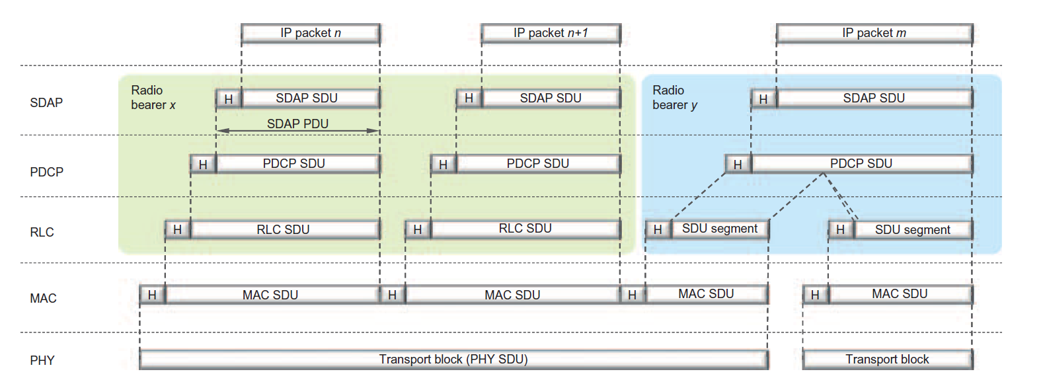
DL Packet Flow in 5G NR RAN Protocols
Figure: The figure is taken from E. Dahlman, S. Parkvall, J. Skoll: “5G NR: The Next Generation Wireless Access Technology,” Academic Press (Elsevier), 2017 (Figures 6.7, page 81)

Slide 28
5G NR Logical Channels
MAC layer provides service to RLC layer in the form of logical channels
Logical channels defined by the type of information they carry
Control channels (control information) and Traffic channels (user data)
BCCH (Broadcast Control Channel)
Delivers system information to all devices in the cell
PCCH (Paging Control Channel)
Paging devices in the network whose location is not known
CCCH (Common Control Channel)
Delivery of control information and for random access
DCCH (Dedicated Control Channel)
Delivery of control information to/from a device
DTCH (Dedicated Traffic Channel)
Delivery of user data to/from a device

Slide 29
5G NR Transport Format Selection
PHY layer provides service to MAC layer in the form of transport channels
How and with what characteristics are data transmitted over radio interface?
Data is organized into Transport Blocks (TB)
Transport Block is transmitted within Transmission Time Interval (TTI)
Details on how TB is transmitted are placed in Transport Format (TF) associated to each TB
TF contains information about: Transport Block Size (TBS), Modulation and Coding Scheme (MCS), Antenna Mapping
Transport Format Selection: MAC scheduler varies Transport Format in order to realize different data rates

Slide 30
5G NR Transport Channels
BCH (Broadcast Channel)
Uses fixed transport format to transmit Master Information Block
PCH (Paging Channel)
Transmission of paging information
DL-SCH (Downlink Shared Channel)
Main transport channel used for DL data. It supports dynamic data rate adaptation, channel dependent scheduling, HARQ, spatial multiplexing, etc.
UL-SCH (Uplink Shared Channel)
Transport channel used for UL data.
RACH (Random Access Channel)
Dedicated for random access procedure

Slide 31
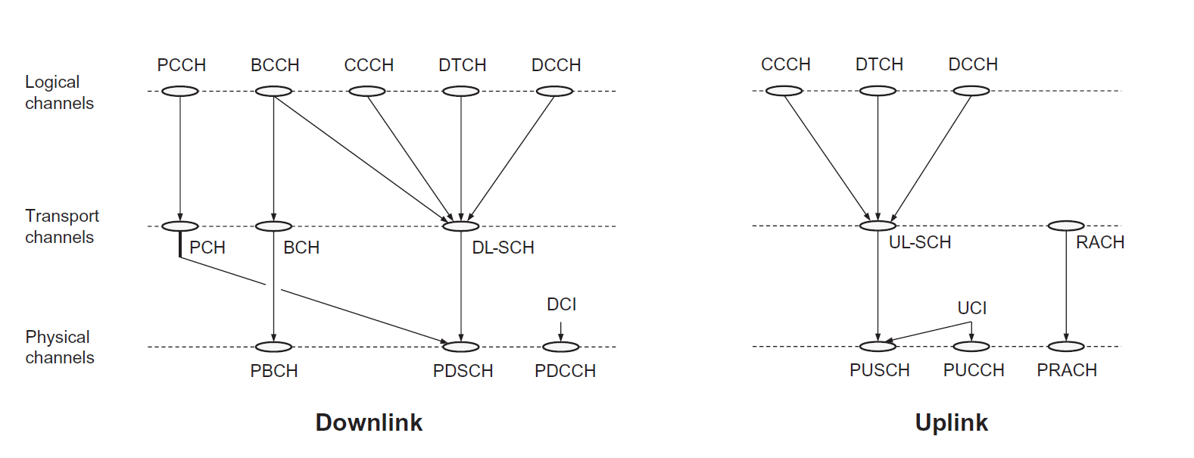
Logical, Transport and Physical Channels
Figure: The figure is taken from E. Dahlman, S. Parkvall, J. Skoll: “5G NR: The Next Generation Wireless Access Technology,” Academic Press (Elsevier), 2017 (Figures 6.11, page 88)

Slide 32
Takeaway Message
We reviewed 3GPP 5G LTE system architecture and explained the role of all logical blocks in 5G Core Network and differences with 4G LTE EPC
Then, we focused on Radio Access Network and investigated protocols that enable RAN connection and pointed out to the minor differences compared to 4G LTE RAN

Slide 33
Further Reading
5G Book, Chapter 6

Slide 34
Introduction to Modern Cellular Networks Part 4: 5G NR Network Architecture and Radio Access Network (RAN) Protocols
Dejan Vukobratovic, Professor

