Slide 1
Course Lecturer
Dr Dejan Vukobratovic
Full Professor
University of Novi Sad, Serbia
Email: dejanv@uns.ac.rs
Homepage: https://sites.google.com/view/vukobratovic
Google Scholar: https://scholar.google.com/citations?user=MugUYHgAAAAJ&hl=en

Slide 2
Course Goal
This course is intended to provide an overview of modern mobile cellular communication systems focusing on 4G Long Term Evolution (LTE) and 5G New Radio (NR) technology and extensions that support cellular Internet of Things (IoT)

Slide 3
Course Literature
Dahlman, E., Parkvall, S. and Skold, J., 2013. 4G: LTE/LTE-advanced for mobile broadband. Academic press. (4G Book)
Dahlman, E., Parkvall, S. and Skold, J., 2020. 5G NR: The next generation wireless access technology. Academic Press. (5G Book)
Zarrinkoub, H., 2014. Understanding LTE with MATLAB: from mathematical modeling to simulation and prototyping. John Wiley & Sons. (4G MATLAB Book)
Liberg, O., Sundberg, M., Wang, E., Bergman, J. and Sachs, J., 2017. Cellular Internet of things: technologies, standards, and performance. Academic Press. (NB-IoT Book)

Slide 4
Introduction to Modern Cellular Networks Part 1: 3GPP Standardization and Evolution of Mobile Cellular Standards
Dejan Vukobratovic, Professor

Slide 5
Outline of the Lecture
Overview of 3GPP Standardization in Mobile Cellular Networks
Evolution of Mobile Cellular Standards and Standardization of 4G and 5G Technology

Slide 6
Standardization of Communication Networks
Standardization organizations create technical standards that guarantee interoperability between equipment of the standardized network technology among different equipment vendors
They provide a forum where all relevant players and stakeholders voice their opinion regarding the directions of the development of communication network technology
Technical standards enable expanding commercial business, faster technology progress and end users enjoying wider choice range, richer functionality and lower costs

Slide 7
Standardization of Communication Networks
The domain of Communication Networks is too complex to define one-solution-fits-all standards
Technical standards for interoperability are a must
The standardization interdependencies accelerate the collaboration between standards development organizations (SDOs).
Explosive increase in end user network utilization requires satisfactory and coherent user experience across heterogeneous networking technologies.

Slide 8
Major Standardization Bodies and Forums
3rd Generation Partnership Project (3GPP)
Institute of Electronic and Electrical Engineers (IEEE)
Internet Engineering Task Force (IETF)
International Telecommunications Union (ITU)
European Telecommunication Standards Institute (ETSI)
The Broadband Forum (BBF)
Open Networking Foundation (ONF)
and many others…

Slide 9
3rd Generation Partnership Project (3GPP)
Formally, not an SDO, not a legal body, but a collaborative project established in 1998. between six SDOs
ARIB, ATIS, CCSA, ETSI, TTA, TTC
3GPP is in charge for developing mobile cellular standards since third generation UMTS system (that explains its name)
3GPP standardization periodically outputs new Releases for mobile cellular standards
The current Release 3GPP is starting to work on is Release 18
More details on 3GPP standardization will come soon…
3GPP technical documents are freely available on the link below
https://www.3gpp.org/

Slide 10
Institute of Electronic and Electrical Engineers (IEEE)
IEEE Standards Association is an organization within IEEE that develops global standards
IEEE-SA is formally not a standard organization
IEEE standardization is best known for IEEE 802 LAN/MAN group
IEEE 802 is a family of standards for PAN, LAN and MAN networks
Among the remaining active standardization groups within IEEE 802, the most important are: 802.3 (Ethernet), 802.11 (Wireless LAN), 802.15 (Wireless PAN), 802.15.4 (Low-Rate Wireless PAN), 802.15.6 Wireless Body Area Networks
IEEE standards are not freely available
https://standards.ieee.org/

Slide 11
Internet Engineering Task Force (IETF)
IETF is an open standards organization, which develops and promotes voluntary Internet standards
IETF develops TCP/IP protocol suite – basis of Internet
IETF is a part of Internet Society (ISOC)
Request for Comments (RFC) are documents published by ISOC
IETF adopts some of the RFC documents as Internet standards
Most of the RFC documents are not standards, some are actually comical
IETF RFC documents are freely available online
https://www.ietf.org/

Slide 12
International Telecommunications Union (ITU)
ITU is a specialized organization within United Nations
Responsible for Inform. and Comm. Technologies (ICT)
Established in 1865 as International Telegraph Union
One of the oldest international organizations
Comprises three sectors: ITU-T (standardization), ITU-R (radio communication, ITU-D (development)
ITU-T responsible for global telecommunications (not radio)
Examples: G.711, JPEG 2000, H.264/AVC, H.265/HEVC, V-series modems, ISDN, SS7 Signaling, SDH, DSL, WDM technologies, etc.
https://www.itu.int/

Slide 13
European Telecommunication Standards Institute (ETSI)
ETSI is an independent, non-profit standards organization in ICT industry
ETSI produces specifications, standards, reports and guidelines
ETSI is one of the founders of 3GPP project
ETSI is leading development in the domain of Network Function Virtualization (NFV) - https://www.etsi.org/technologies/nfv
ETSI also supports development of Multi-Access Edge Computing - https://www.etsi.org/technologies/multi-access-edge-computing
https://www.etsi.org/

Slide 14
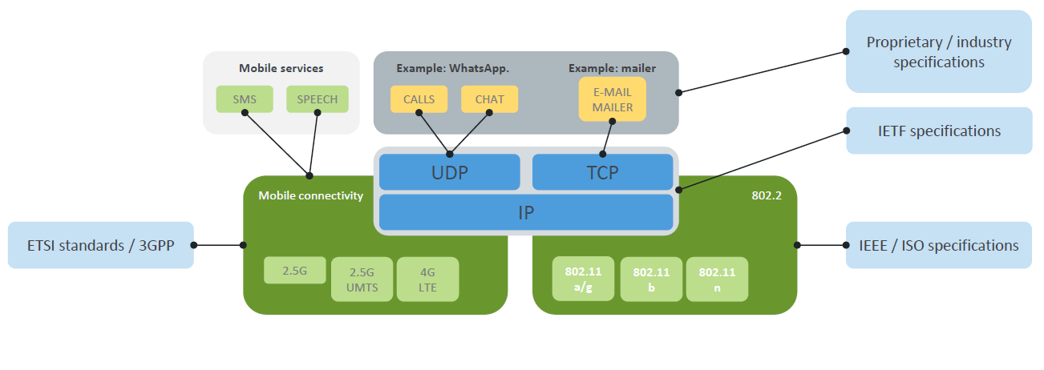
Standards in Your Mobile Phone
“Understanding ETSI Standardization: Principles and Practice”, https://www.etsi.org/standardization-education

Slide 15
Standardization in Mobile Cellular Communications
Standard Developing Organizations (SDO)
Develop and agree on technical standards to ensure global interoperability
SDOs are usually non-profit and not govermentally controlled
3GPP is global organization mandated by 7 regional and national SDOs
Regulatory Bodies and Administrations
Government-led organizations that set regulatory and legal requirements
Control RF spectrum use and set licencing conditions
Industry Forums
Industry-led groups for technology promotion and lobbying for specific technologies or other interests (e.g., GSMA)

Slide 16
Standardization: The main actors
Regulatory bodies
Define requirements
Standardization organizations
Develop standards
Product vendors
Develop standard-compliant products
Network operators
Provide services using standard-compliant equipment
Figure: E. Dahlman, S. Parkvall, J. Skoll: “5G NR: The Next Generation Wireless Technology,” Academic Press (Elsevier), 2018 (Figure 2.1, page 9)

Slide 17
International Telecommunications Union
ITU is international Standard Developing Organization
ITU-R is the ITU sector for radio communications
ITU-R responsible for ensuring efficient and economical spectrum usage
ITU-R implements international Radio Regulations, and international binding treaties on how RF spectrum is used
Radio regulations are revised and updated every 3-4 years at the ITU World Radio Conference (WRC)
The last one is held in 2019 in Sharm El-Sheikh in Egypt
While the technical specs are developed by 3GPP, ITU-R responsibility is to make them global standards

Slide 18
Standardization: How does it work?
First step: Technology Requirements
Int’l Telecommunications Union – Radio Communications Sector (ITU-R)
Technical requirements, evaluation guidelines and submission template
IMT-2000 (3G), IMT-Advanced (4G), IMT-2020 (5G)
Second step: Technology Standardization
3rd Generation Partnership Project (3GPP): www.3gpp.org
Contributions from industrial, operator and academic partners
Third step: Spectrum allocation
Organized by ITU-R during World Radio Conference (WRC)

Slide 19
3GPP Standardization Groups
3 technical specification groups (TSGs) divided into 6 working groups (WGs)
RAN WG1 – Physical layer
RAN WG2 – L2 and L3 radio interface
RAN WG3 – Interface Radio Access Network (RAN) – Core Network (CN)
RAN WG4 – Radio Frequency (RF) and Radio Resource Management (RRM)
RAN WG5 – Device Conformance Tests
RAN WG6 – Legacy Technologies
Figure: E. Dahlman, S. Parkvall, J. Skoll: “5G NR: The Next Generation Wireless Technology,” Academic Press (Elsevier), 2018 (Figure 2.9, page 23)

Slide 20
3GPP Standardization Process
Developing technical specifications
Long and iterative process, consists of four phases:
Requirements: What is designed?
Architecture: Main building blocks.
Detailed Specifications: Detailed description of each block.
Testing and Verification: Testing in real-world environment.
Figure: E. Dahlman, S. Parkvall, J. Skoll: “5G NR: The Next Generation Wireless Technology,” Academic Press (Elsevier), 2018 (Figure 2.8, page 22)

Slide 21
Outline of the Lecture
Overview of 3GPP Standardization in Mobile Cellular Networks
Evolution of Mobile Cellular Standards and Standardization of 4G and 5G Technology

Slide 22
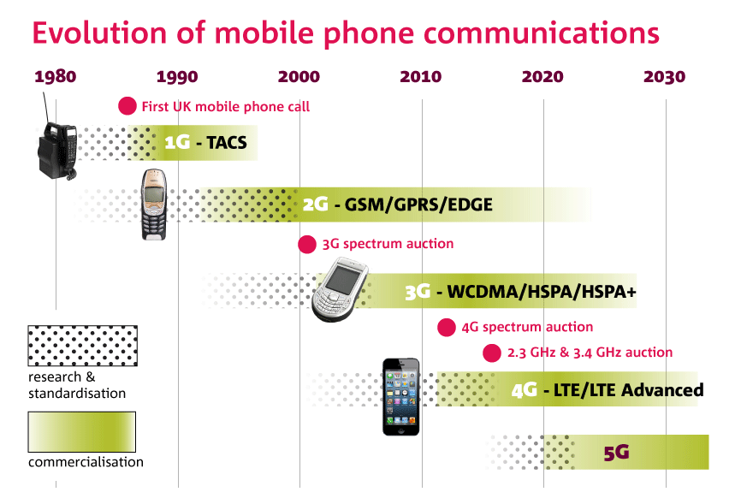
Evolution of Mobile Cellular Standards
Development of new G
Research phase starts 10 years before the standard is adopted
We are at the beginning of 6G research that will be standardized in 2030
From 3G the process is defined under 3GPP standardization

Slide 23
GSM/EDGE Networks (2G)
GSM deployment started in 1992
GSM is most widely deployed cellular standard in the world
2.5 billions of subscribers today
EDGE: Enhancement of GSM
Enhanced Data Rates for GSM Evolution
GSM/EDGE evolution done under 3GPP releases
GSM/EDGE Radio Access Network (GERAN)
Some countries removed GSM from their mobile radio network

Slide 24
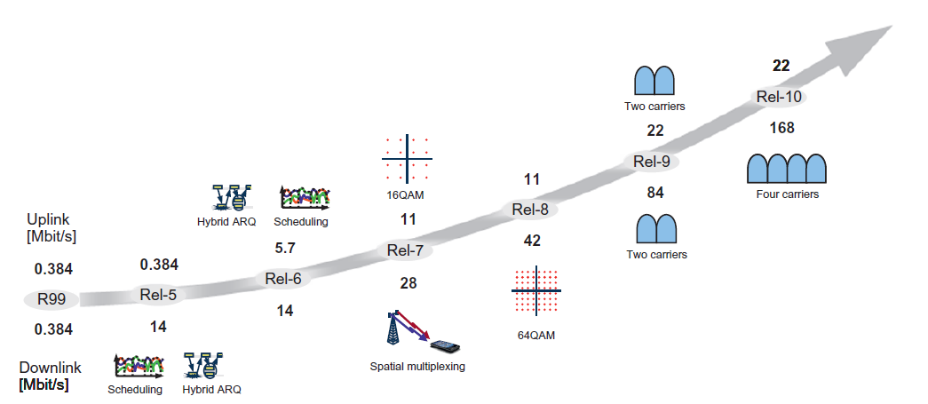
WCDMA/HSPA Networks (3G)
Wideband CDMA (WCDMA) is dominant 3G technology
Originally developed by 3GPP in Release 5 of standards
High-Speed Packet Access (HSPA) is evolution of WCDMA
HSPA has been improved through 3GPP Releases from Release 5 to 10
Figure: This figure is taken from E. Dahlman, S. Parkvall, J. Skoll: “4G LTE/LTE-Advanced for Mobile Broadband,” Academic Press (Elsevier), 2011 (Figure 19.1, page 390)

Slide 25
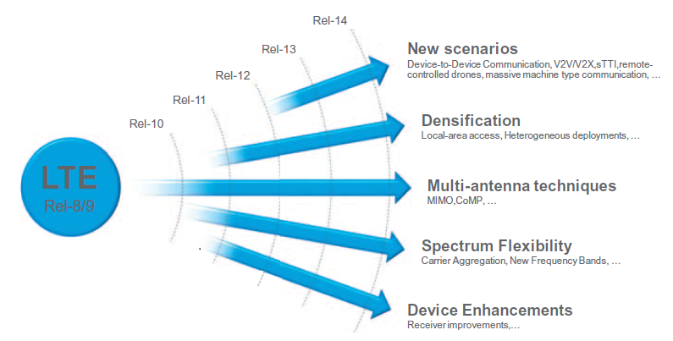
4G Long-Term Evolution (LTE) Standardization
3GPP docs divided into releases
Rel. 8: 4G LTE (2008)
6 LTE Releases (updates) since then
Rel. 10: LTE-Advanced (2010)
Rel. 13: LTE-Advanced Pro (2015)
Rel. 15: 5G New Radio (NR)
Figure: These figures are taken from E. Dahlman, S. Parkvall, J. Skoll: “5G NR: The Next Generation Wireless Technology,” Academic Press (Elsevier), 2018 (Figures 4.1 and 4.2, pages 41/42)

Slide 26
5G New Radio (NR) Standardization
5G targets delivery of three new services
eMBB: enhanced Mobile Broadband
mMTC: massive Machine-Type Communications
URLLC: Ultra-Reliable Low-Latency Communications
To accommodate three different service requirements, novel and more flexible NR radio interface has been designed

Slide 27
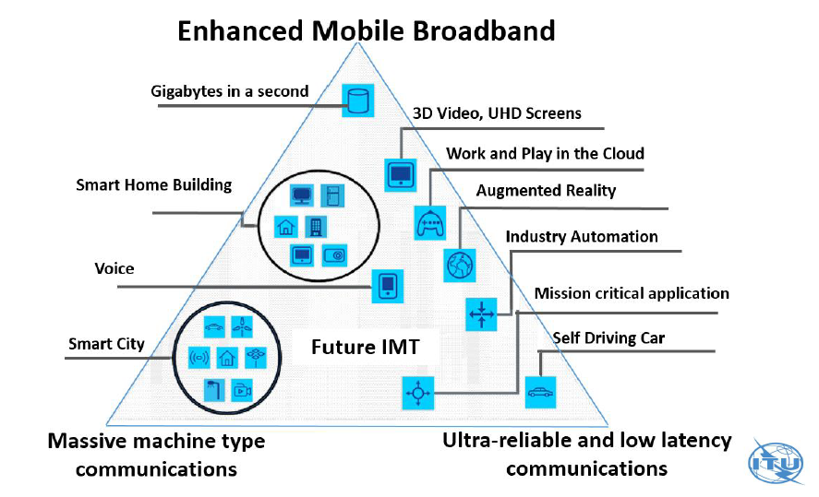
IMT-2020 Service Requirements

Slide 28
eMBB: Enhanced Mobile Broadband
Future evolution of 4G concept
Increased data rates to mobile terminal
Multimedial services (UHD, 3D/360, VR/AR)
Entertainment industry (TV, movies, music) and gaming
Technical requirements
Downlink > 20 Gb/s; Uplink > 10 Gb/s
100 Mb/s everywhere (> 95% ćelije); 10.000 x more traffic volume

Slide 29
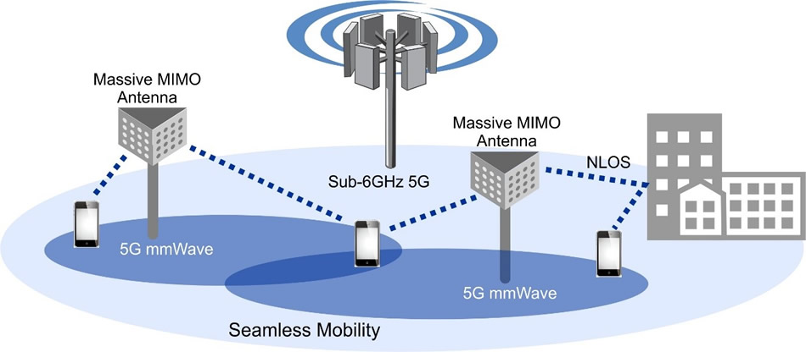
eMBB: Enhanced Mobile Broadband
https://www.accton.com/

Slide 30
URLLC: Ultra Reliable and Low Latency Communications
Ultra-reliability and low latency
5G for industrial applications (robot control)
5G for medical applications (tele-surgery)
5G for autonomous vehicles (vehicular control)
Requirements
Latency: ~ 1 ms
PLR < 10⁻⁵
Greatest challenge for wireless tehnology

Slide 31
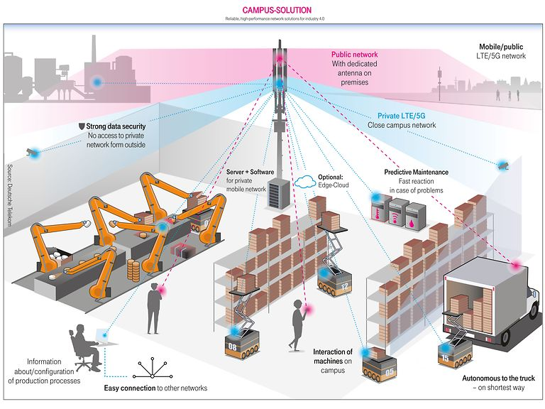
URLLC: Ultra Reliable and Low Latency Communications
https://www.t-mobile.com/

Slide 32
URLLC: Ultra Reliable and Low Latency Communications
https://www.qualcomm.com/invention/5g/cellular-v2x

Slide 33
mMTC: massive Machine-Type Communications
Massive connectivity for billions of devices
5G for Smart City
5G for Smart Agriculture
5G for Smart Energy
Requirements
No of devices: > 10⁶ / km²
It is much easier to provide 1 Gb/s to a single user than 1 Mb/s to 1000 users!
First and important steps in 4G: NarrowBand IoT (NB-IoT)

Slide 34
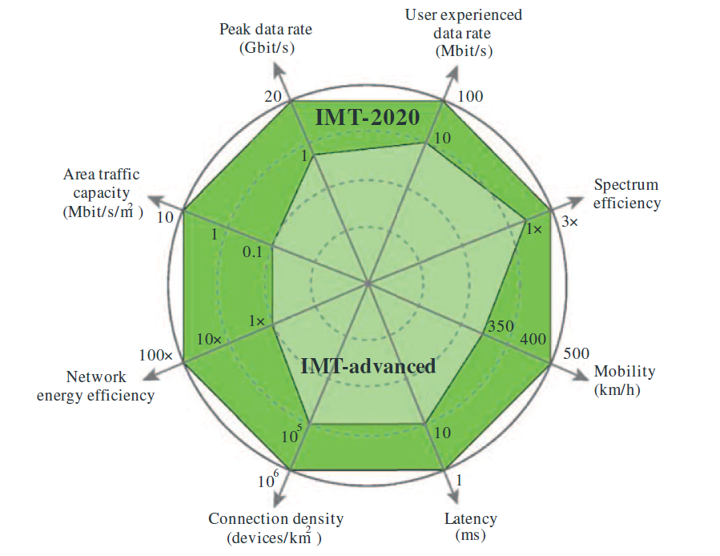
Key Capabilities of IMT-2020
Figure: E. Dahlman, S. Parkvall, J. Skoll: “5G NR: The Next Generation Wireless Technology,” Academic Press (Elsevier), 2018 (Figure 2.6, page 16)

Slide 35
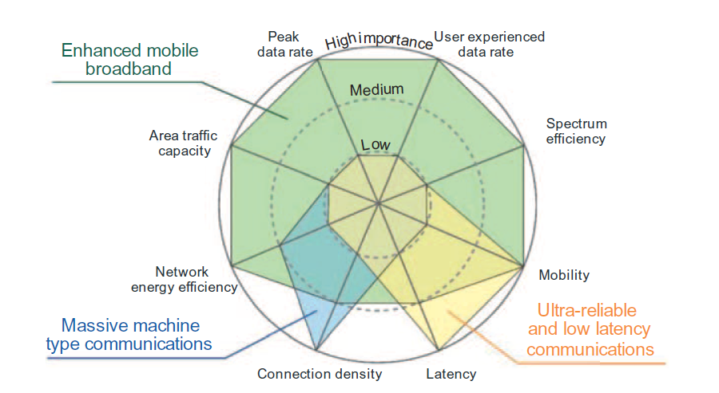
Capabilities of IMT-2020 per Service Categories
Figure: E. Dahlman, S. Parkvall, J. Skoll: “5G NR: The Next Generation Wireless Technology,” Academic Press (Elsevier), 2018 (Figure 2.7, page 17)

Slide 36
Takeaway Message
We explained the basics of 3GPP standardization process in charge of development of mobile cellular technologies
We explained the current state of 3GPP 4G and 5G technology standardization and recalled of evolution of previous mobile cellular standards

Slide 37
Further Reading
5G Book, Chapter 1 and 2

Slide 38
Introduction to Modern Cellular Networks Part 1: 3GPP Standardization and Evolution of Mobile Cellular Standards
Dejan Vukobratovic, Professor

