Slide 1
Introduction to Modern Cellular Networks Part 3: 4G LTE Network Architecture and Radio Access Network (RAN) Protocols
Dejan Vukobratovic, Professor

Slide 2
Outline of the Lecture
Overview of 3GPP LTE System Architecture
LTE Radio Access Network (RAN) Protocols

Slide 3
4G LTE System Architecture
Evolved Packet System (EPS)
Generic name for 4G LTE system architecture
Consists of two parts: RAN and EPC
Radio Access Network (RAN)
Responsible for all radio-related functionality (scheduling, radio resource handling, retransmission protocols, coding, multi-antenna systems, etc.)
Evolved Packet Core (EPC)
Everything else apart from radio interface (authentication, charging, end-to-end connection setup).
Functional split: EPC may serve different radio technologies

Slide 4
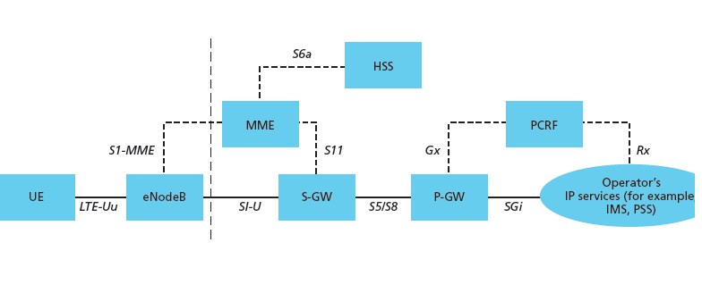
Evolved Packet Core (EPC)
Main Architecture Blocks and Interfaces
EPC is based on packet-switched (IP) data transmission
Contains user plane and control plane interfaces and logical blocks
Several logical blocks may be part of a single physical node

Slide 5
Packet Gateway (PGW)
Packet Gateway (PGW)
Connects EPC to the Internet (central mobile network router)
Handles allocation of IP addresses to each UE
Implements Quality of Service (QoS) according to the defined policies
Mobility anchor to other non-3GPP networks (e.g., CDMA 2000)

Slide 6
Mobility Management Entity (MME)
Mobility Management Entity (MME)
Main signalling (control-plane) node of EPC
Also called Non-Access Stratum (NAS)
Connection and release of bearers to each user equipment (UE)
Handling activity of connections (ACTIVE/IDLE states)

Slide 7
Serving Gateway (SGW)
Serving Gateway (SGW)
Data forwarding node between eNBs and PGW
User-plane node connecting EPC to the RAN
Serves as mobility anchor as mobile terminals move between eNBs and for other 3GPP technologies (GSM/HSPA)
Collection of information and statistics needed for charging

Slide 8
Network Elements (HSS/PCRW)
Home Subscriber Service (HSS)
Data base containing subscriber information
Policy and Charging Rules Function (PCRF)
Responsible for QoS handling and charging

Slide 9
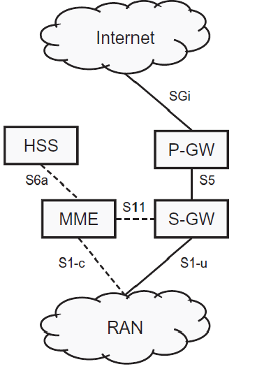
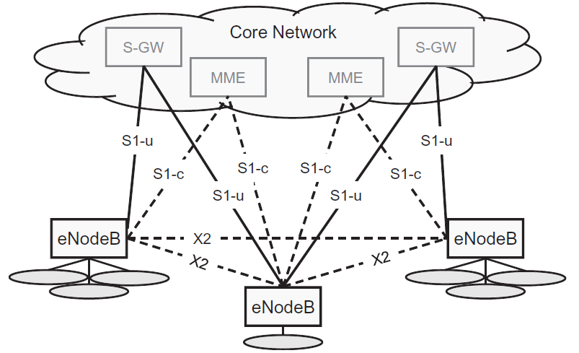
LTE System Architecture and Interfaces
Figures: These figures are taken from E. Dahlman, S. Parkvall, J. Skoll: “4G LTE/LTE-Advanced for Mobile Broadband,” Academic Press (Elsevier), 2011 (Figures 8.1 and 8.2, page 110)

Slide 10
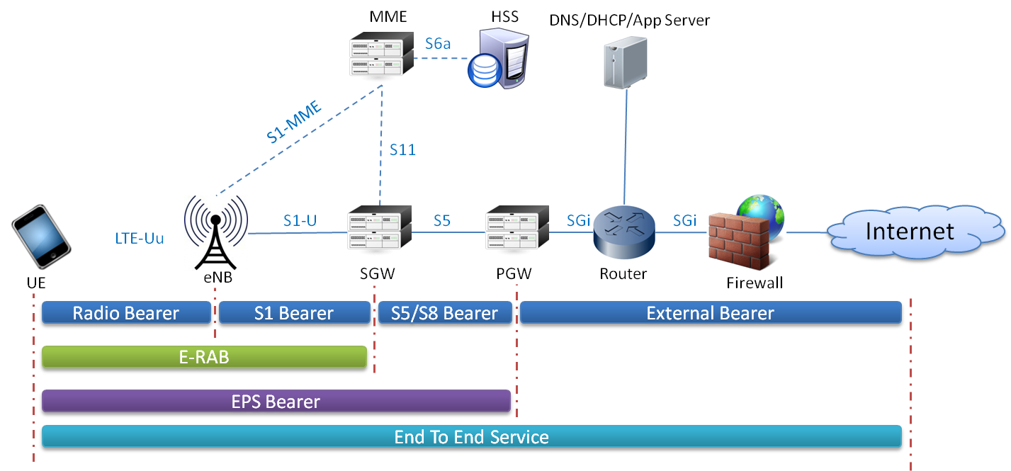
LTE Bearers
IP connections (tunnels) that connect UE to packet data network (Internet)
At least one (default) bearer is established between UE and PGW
Bearer concatenates three tunnels: S5, S1, and Radio bearer

Slide 11
Outline of the Lecture
Overview of 3GPP LTE System Architecture
LTE Radio Access Network (RAN) Protocols

Slide 12
Radio Access Network and eNB node
evolved Node B (eNB) – Base station
LTE RAN is flat in architecture – contains only base stations (eNB)
eNB is logical node and can be implemented in various ways:
Standard three-sector macro-cellular site
Baseband processing unit (BBU) with a number of remote radio heads (RRH)
Indoor base station systems with distributed antennas
Highway base stations with many antennas along the highway
eNB Interfaces
S1-U user data interface towards SGW/PGW
S1-C control plane interface towards MME
X2 interface towards neighboring eNBs
Figure: This figure is taken from E. Dahlman, S. Parkvall, J. Skoll: “4G LTE/LTE-Advanced for Mobile Broadband,” Academic Press (Elsevier), 2011 (Figure 8.1, page 110)

Slide 13
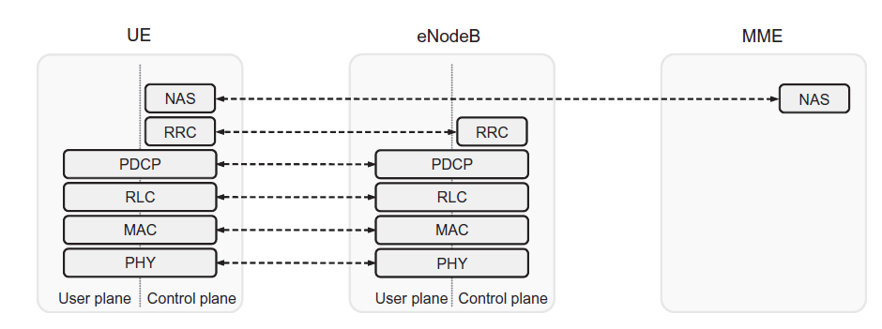
Radio Access Network Architecture
RAN architecture
4 protocols (PDCP/RLC/MAC/PHY) covering L1/L2 functionality
serve both user data (IP packets) and control data (NAS/RRC messages)
Figure: This figure is taken from E. Dahlman, S. Parkvall, J. Skoll: “4G LTE/LTE-Advanced for Mobile Broadband,” Academic Press (Elsevier), 2011 (Figure 8.3, page 112)

Slide 14
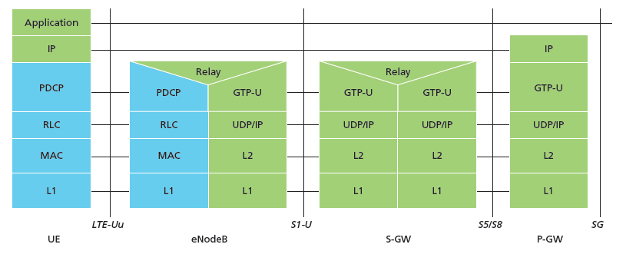
Radio Access Network Architecture
RAN architecture
RAN protocols (PDCP/RLC/MAC/PHY) enable establishing radio bearer
Other bearers (S1 and S5/S8) use GPRS tunneling protocol (GTP) to tunnel IP data to/from EPC nodes (SGW and PGW) in order to establish EPS bearer

Slide 15
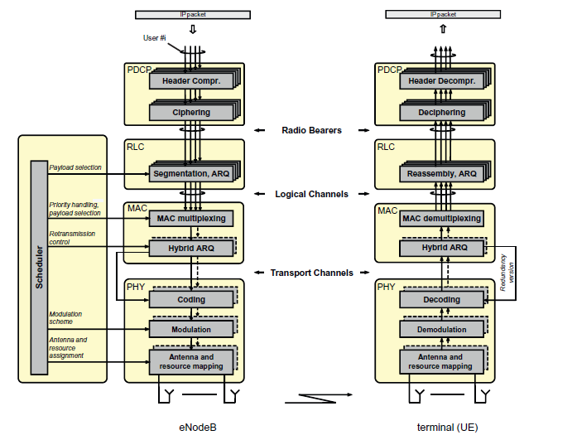
Radio Access Network Architecture
Packet Data Convergence Protocol PDCP
Performs IP header compression using ROHC (Robust Header Compression)
Data ciphering
Integrity check of control data packets
In-sequence delivery and duplicate removal (during handover)
One PDCP entity per radio bearer
Figure: This figure is taken from E. Dahlman, S. Parkvall, J. Skoll: “4G LTE/LTE-Advanced for Mobile Broadband,” Academic Press (Elsevier), 2011 (Figure 8.4, page 112)

Slide 16
Radio Access Network Architecture
Radio Link Control Protocol RLC
Segmentation/concatenation to create variable size RLC PDUs based on scheduler decisions
RLC retransmission using ARQ mechanism
Duplicate detection and in-sequence delivery to PDCP
One RLC entity per radio bearer
Figure: This figure is taken from E. Dahlman, S. Parkvall, J. Skoll: “4G LTE/LTE-Advanced for Mobile Broadband,” Academic Press (Elsevier), 2011 (Figure 8.4, page 112)

Slide 17
Radio Access Network Architecture
Medium Access Control Protocol MAC
Provides services to RLC in the form of logical channels
Performs multiplexing of logical channels
Uplink and downlink scheduling (located at eNB for both UL/DL)
Hybrid ARQ (HARQ) retransmissions
MAC frame size aligned to PHY transport block (TB) size which depends on PHY configuration
Figure: This figure is taken from E. Dahlman, S. Parkvall, J. Skoll: “4G LTE/LTE-Advanced for Mobile Broadband,” Academic Press (Elsevier), 2011 (Figure 8.4, page 112)

Slide 18
Radio Access Network Architecture
Physical Layer Protocol PHY
Provides services to MAC layer in the form of physical channels
Error correction coding and decoding
Adaptive modulation and OFDM resource grid mapping
MIMO antenna system signal processing
Figure: This figure is taken from E. Dahlman, S. Parkvall, J. Skoll: “4G LTE/LTE-Advanced for Mobile Broadband,” Academic Press (Elsevier), 2011 (Figure 8.4, page 112)

Slide 19
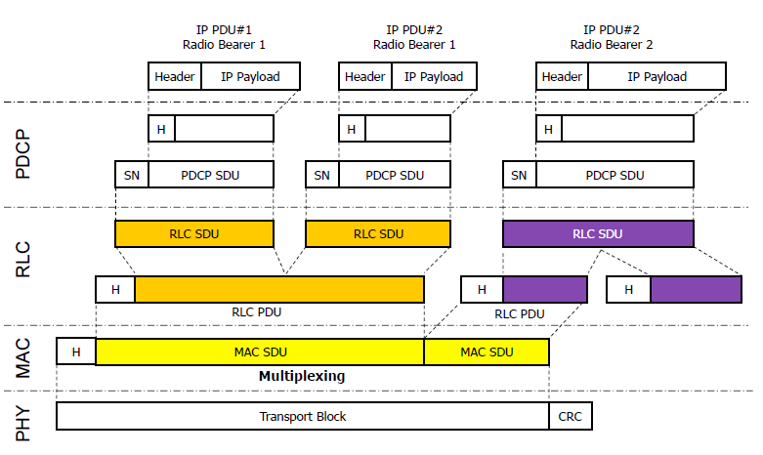
Radio Access Network Architecture
Figure: This figure is taken from E. Dahlman, S. Parkvall, J. Skoll: “4G LTE/LTE-Advanced for Mobile Broadband,” Academic Press (Elsevier), 2011 (Figure 8.5, page 114)

Slide 20
Logical, Transport and Physical Channels
Logical channels
Interface between RLC and MAC
Different logical channels are mapped onto transport channels
Transport channels
Interface between MAC and PHY
Different transport channels are mapped onto physical channels
Physical channels
Carry transport blocks
Figure: This figure is taken from E. Dahlman, S. Parkvall, J. Skoll: “4G LTE/LTE-Advanced for Mobile Broadband,” Academic Press (Elsevier), 2011 (Figure 8.1, page 110)

Slide 21
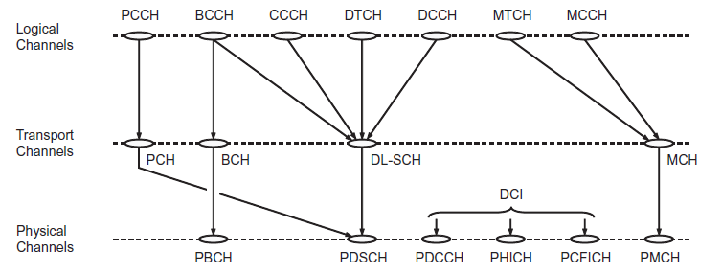
Logical, Transport and Physical Channels (Downlink)
Logical Channels
PCCH – Paging Control Channel
BCCH – Broadcast Control Channel
CCCH – Common Control Channel
DTCH – Dedicated Traffic Channel
DCCH – Dedicated Control Channel
MTCH – Multicast Traffic Channel
MCCH – Multicast Control Channel
Figure: This figure is taken from E. Dahlman, S. Parkvall, J. Skoll: “4G LTE/LTE-Advanced for Mobile Broadband,” Academic Press (Elsevier), 2011 (Figure 8.7, page 117)

Slide 22
Logical, Transport and Physical Channels (Downlink)
Transport Channels
PCH – Paging Channel
BCH – Broadcast Channel
DL-SCH – Downlink Shared Channel
MCH – Multicast Channel
Figure: This figure is taken from E. Dahlman, S. Parkvall, J. Skoll: “4G LTE/LTE-Advanced for Mobile Broadband,” Academic Press (Elsevier), 2011 (Figure 8.7, page 117)

Slide 23
Logical, Transport and Physical Channels (Downlink)
Physical Channels
PBCH – Physical Broadcast Channel
PDSCH – Physical Downlink Shared Channel
DCI – Downlink Control Information
PMCH – Physical Multicast Channel
Figure: This figure is taken from E. Dahlman, S. Parkvall, J. Skoll: “4G LTE/LTE-Advanced for Mobile Broadband,” Academic Press (Elsevier), 2011 (Figure 8.7, page 117)

Slide 24
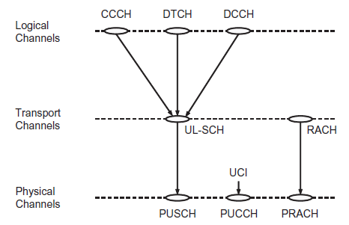
Logical, Transport and Physical Channels (Uplink)
Logical Channels
CCCH – Common Control Channel
DTCH – Dedicated Traffic Channel
DCCH – Dedicated Control Channel
Transport Channels
UL-SCH – Uplink Shared Channel
RACH – Random Access Channel
Physical Channels
PUSCH – Physical Uplink Shared Channel
PUCCH – Physical Uplink Control Channel
PRACH – Physical Random Access Channel
Figure: This figure is taken from E. Dahlman, S. Parkvall, J. Skoll: “4G LTE/LTE-Advanced for Mobile Broadband,” Academic Press (Elsevier), 2011 (Figure 8.8, page 118)

Slide 25
Takeaway Message
We reviewed 3GPP 4G LTE system architecture and explained the role of all logical blocks in the Evolved Packet Core networks
Then, we focused on Radio Access Network and investigated protocols that enable RAN communication: PDCP, RLC, MAC and PHY layer protocols. For the most of the course, PHY layer will be the focus of our exploration

Slide 26
Further Reading
4G Book, Chapter 8

Slide 27
Introduction to Modern Cellular Networks Part 3: 4G LTE Network Architecture and Radio Access Network (RAN) Protocols
Dejan Vukobratovic, Professor

