Slide 1
Introduction to Modern Cellular Networks Part 6: 4G LTE Radio Interface – Part 2
Dejan Vukobratovic, Professor

Slide 2
4G LTE Radio Interface
4G LTE radio interface is designed to deliver IP packets from the base station (eNB) to the mobile device (UE) in the downlink, or vice versa in the uplink
After processing IP packets on layer 2 via PDCP, RLC and MAC sublayers (see part 3 and 4 lectures), MAC frames are delivered to physical layer (PHY) for physical signal transmission
LTE PHY is the key part and it is worth introducing its basics!

Slide 3
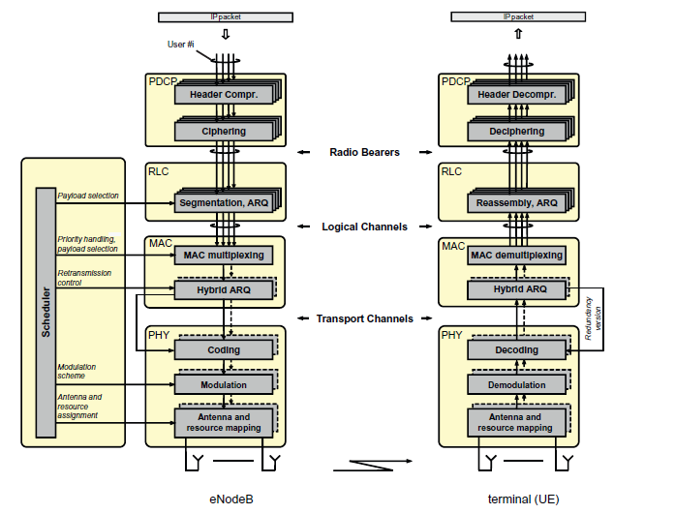
4G LTE PHY Signal Processing

Slide 4
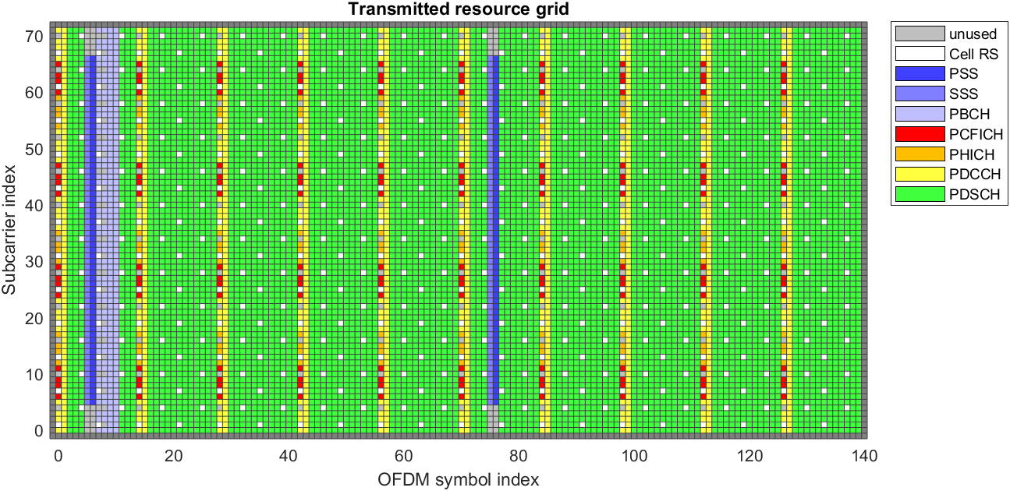
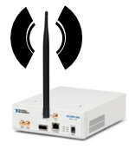
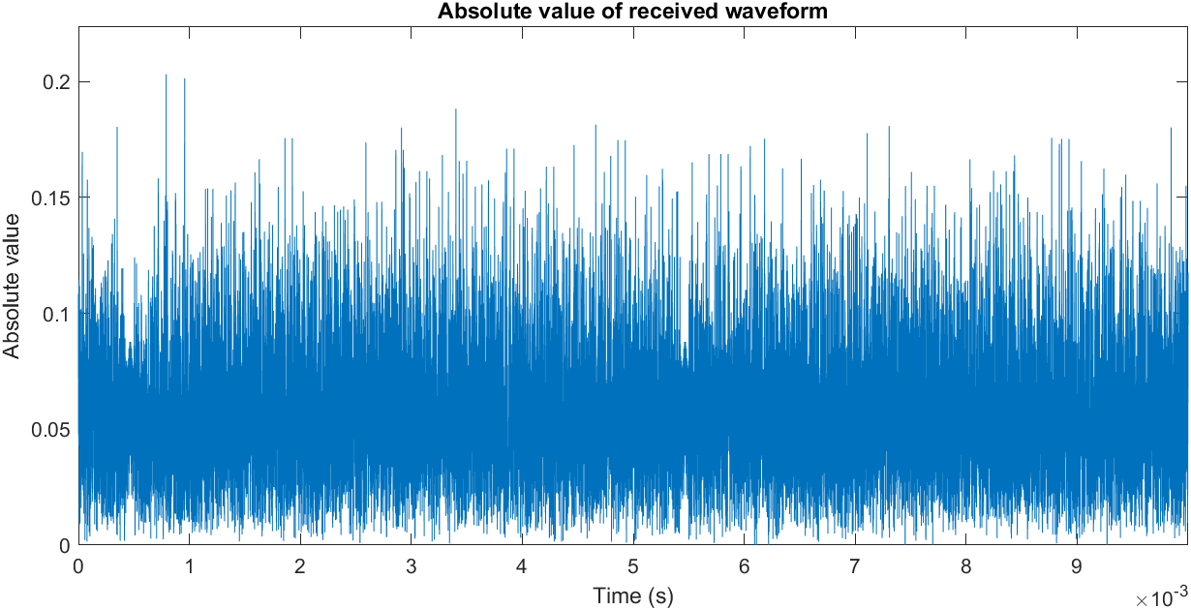
4G LTE PHY Signal Processing
0
1
0
0
0
1
1
0
1
0
1
1
0
K bits
MAC
PHY
Turbo Codes
CRC, FEC CODING, RATE MATCHING, SCRAMBLING
0
1
0
0
0
1
1
0
1
0
1
1
0
0
1
0
1
1
0
N bits
MODULATION, RESOURCE GRID MAPPING
QPSK, 16-QAM, 64-QAM
PHY signals
PHY channels
OFDM MODULATION
RF

Slide 5
4G LTE PHY Signal Processing
0
1
0
0
0
1
1
0
1
0
1
1
0
K bits
MAC
PHY
Turbo Codes
CRC, FEC CODING, RATE MATCHING, SCRAMBLING
0
1
0
0
0
1
1
0
1
0
1
1
0
0
1
0
1
1
0
N bits
MODULATION, RESOURCE GRID MAPPING
QPSK, 16-QAM, 64-QAM
PHY signals
PHY channels
OFDM MODULATION
RF

Slide 6
Outline of the Lecture
Resource Grid Mapping
OFDM Modulation

Slide 7
Resource Grid
Resource Grid is a key structure for understanding LTE signal
Resource Grid represents how LTE signal is organized in time and frequency domain
Time domain: Time division of LTE signal into:
Frames
Subframes and Slots
OFDM symbols
Frequency domain: Frequency division of LTE signal into:
Resource Blocks
OFDM sub-carriers

Slide 8
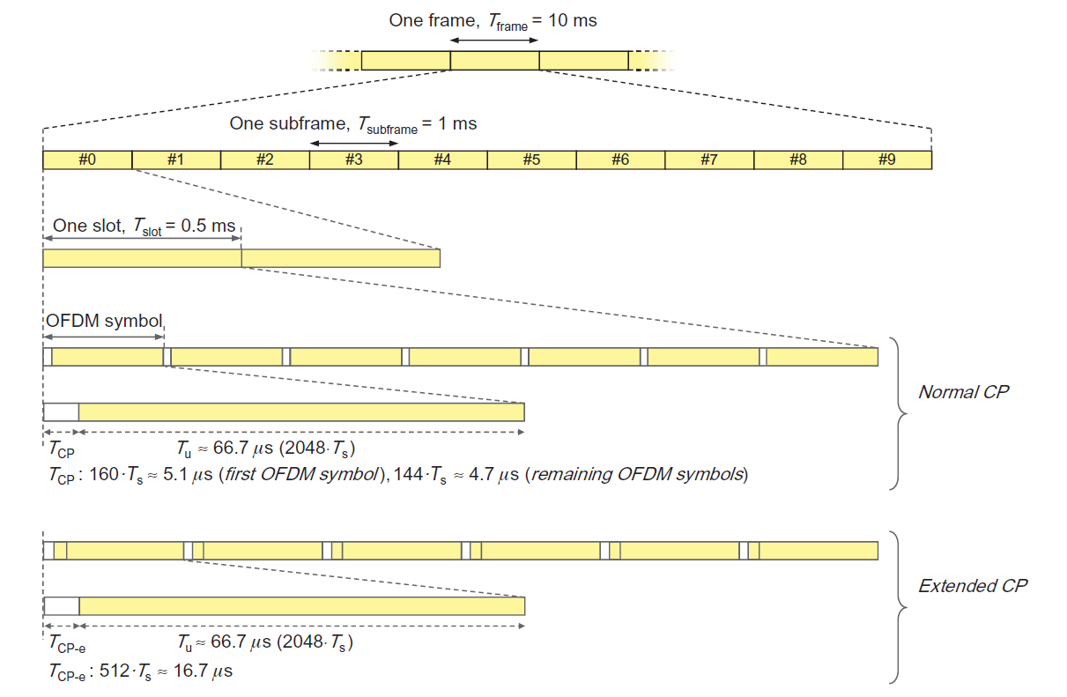
4G LTE Time Frame Structure
Figure: This figure is taken from E. Dahlman, S. Parkvall, J. Skoll: “4G LTE/LTE-Advanced for Mobile Broadband,” Academic Press (Elsevier), 2011 (Figure 9.1, page 129)

Slide 9
4G LTE Time Frame Structure
In time domain, LTE transmission is organized into 10 ms LTE frames
Each frame is organized into 10 subframes of duration 1 ms
Each subframe consists of two slots where each slot is 0.5 ms
Frames are enumerated modulo 1024 using so called System Frame Numbers (SFN)
Figure: This figure is taken from E. Dahlman, S. Parkvall, J. Skoll: “4G LTE/LTE-Advanced for Mobile Broadband,” Academic Press (Elsevier), 2011 (Figure 9.1, page 129)

Slide 10
4G LTE Time Frame Structure
Slot consists of OFDM symbols
OFDM symbol containes useful part and cyclic prefix (CP)
LTE defines two lengths of CP
Normal CP - 7 OFDM symbols in a slot
Extended CP – 6 OFDM symbols in a slot
Extended cyclic prefix defined to accommodate very large cells
Figure: This figure is taken from E. Dahlman, S. Parkvall, J. Skoll: “4G LTE/LTE-Advanced for Mobile Broadband,” Academic Press (Elsevier), 2011 (Figure 9.1, page 129)

Slide 11
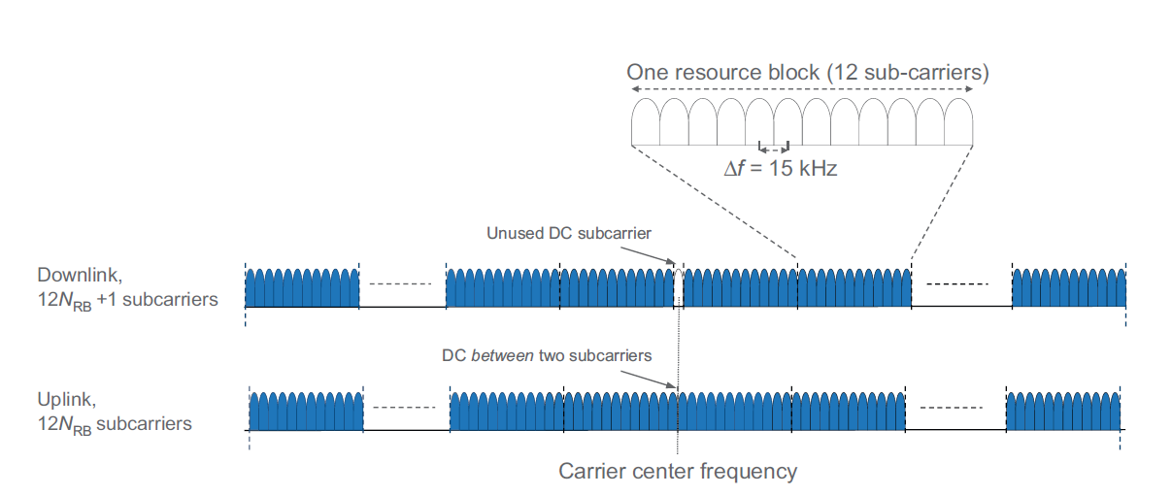
4G LTE Frequency Domain Structure
Figure: This figure is taken from E. Dahlman, S. Parkvall, J. Skoll: “4G LTE/LTE-Advanced for Mobile Broadband,” Academic Press (Elsevier), 2011 (Figure 9.3, page 131)

Slide 12
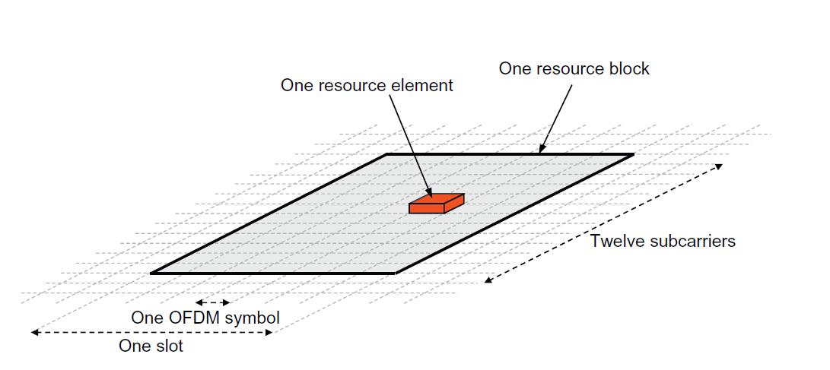
Resource Grid Basics
Resource Element: Smallest physical resource in LTE
One subcarrier during one OFDM symbol
Carries a single modulation symbol (QPSK, 16-QAM, 64-QAM)
Figure: This figure is taken from E. Dahlman, S. Parkvall, J. Skoll: “4G LTE/LTE-Advanced for Mobile Broadband,” Academic Press (Elsevier), 2011 (Figure 9.2, page 130)

Slide 13
Resource Grid Basics
Resource Block: Grouping of resource elements
Contains 12 consecutive subcarriers in frequency domain and a single slot (0.5 ms) in time domain
12 * 7 = 84 Resource Elements (in case of normal CP)
Figure: This figure is taken from E. Dahlman, S. Parkvall, J. Skoll: “4G LTE/LTE-Advanced for Mobile Broadband,” Academic Press (Elsevier), 2011 (Figure 9.2, page 130)

Slide 14
Resource Grid Basics
Resource Block Pair: A pair of Resource Blocks in one subframe
Minimal allocation unit for dynamic scheduling in LTE
Figure: This figure is taken from E. Dahlman, S. Parkvall, J. Skoll: “4G LTE/LTE-Advanced for Mobile Broadband,” Academic Press (Elsevier), 2011 (Figure 9.2, page 130)

Slide 15
Resource Grid Basics
Resource Grid: Can be visually represented as a matrix
Rows: OFDM subcarriers, organised in groups of 12 subcarriers called Resource Blocks
Columns: OFDM symbols, organised into slots (7 symbols) and subframes (14 symbols)
Every 1 ms, LTE fills one subframe of data with modulation symbols and transmits it via radio interface
Every subframe carries a specific set of physical channels (different subframes may carry different configuration of physical channels)

Slide 16
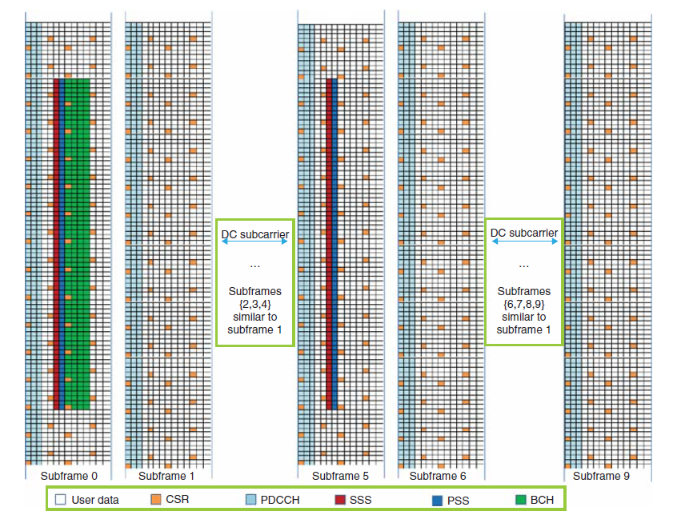
Downlink Resource Grid
Mapping different physical channels to subframes of Resource Grid

Slide 17
Downlink Resource Grid
DL Resource Grid multiplexes six different types of data:
CSR – Cell-Specific Reference Signals
PSS – Primary Synchronization Signal
SSS – Secondary Synchronization Signal
System information (BCH symbols)
User data (PDSCH symbols)
Control data (PDCCH symbols)
Some of these signals/channels are available in each SF (CSR, PDSCH, PDCCH) while other are available only in specific SF (BCH in SF0, PSS and SSS in SF0 and SF5)

Slide 18
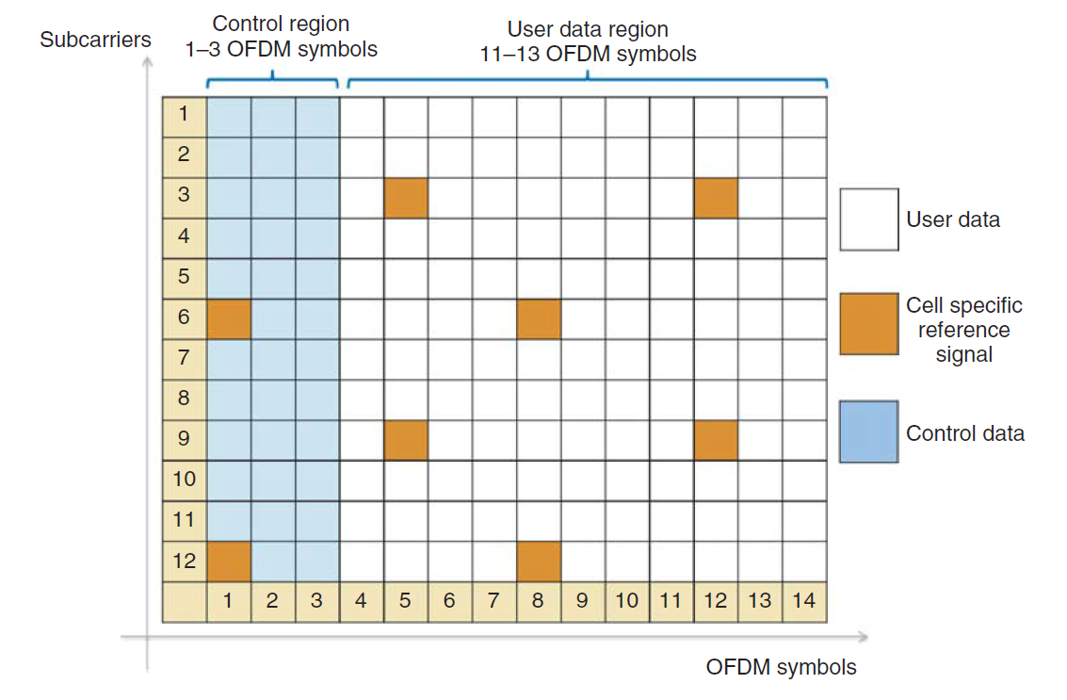
Resource Block and Physical Channels
Single Resource Block of Resource Grid with different PHY channels

Slide 19
Cell Specific Reference Signals (CSR)
Transmitted in every DL subframe and in every resource block
Used by the terminal for channel estimation and coherent demodulation of physical channels
Used by terminal to acquire Channel State Information (CSI)
Terminal measurements on CSR used for cell reselection and handover

Slide 20
Bandwidth Allocation in 4G LTE
LTE supports different bandwidths
Minimum signal BW is 1.4 MHz
Only 6 Resource Blocks + Guard band
Maximum signal is 20 MHz
100 Resource Blocks
Carrier Aggregation: In later Releases, multiple 20MHz carriers are aggregated to provide wider bandwidth
Figure: This table is taken from Zarrinkoub, H., “Understanding LTE with MATLAB: from mathematical modeling to simulation and prototyping,” John Wiley & Sons (Table 2.3 and 2.5, page 16 and 23)

Slide 21
Outline of the Lecture
Resource Grid Mapping
OFDM Modulation

Slide 22
4G LTE PHY Signal Processing
0
1
0
0
0
1
1
0
1
0
1
1
0
K bits
MAC
PHY
Turbo Codes
CRC, FEC CODING, RATE MATCHING, SCRAMBLING
0
1
0
0
0
1
1
0
1
0
1
1
0
0
1
0
1
1
0
N bits
MODULATION, RESOURCE GRID MAPPING
QPSK, 16-QAM, 64-QAM
PHY signals
PHY channels
OFDM MODULATION
RF

Slide 23
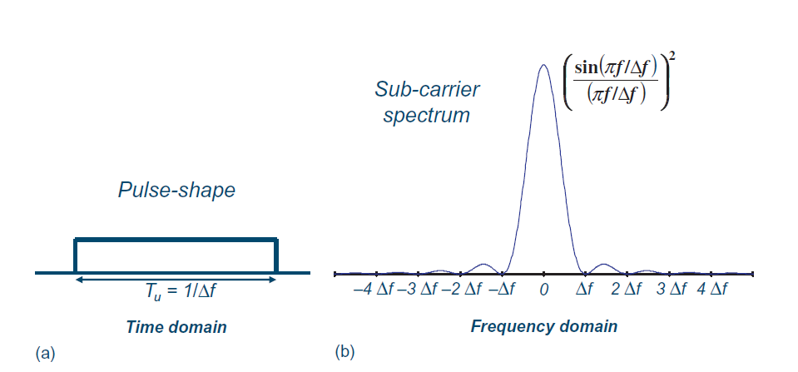
OFDM Basics
OFDM represents a multi-carrier transmission technique that uses a very large relatively narrow subcarriers (order of hundreds or more)
Time Domain: Signals at individual carriers are a simple rectangular shaping
Figure: This figure is taken from E. Dahlman, S. Parkvall, J. Skoll: “4G LTE/LTE-Advanced for Mobile Broadband,” Academic Press (Elsevier), 2011 (Figure 3.1, page 28)

Slide 24
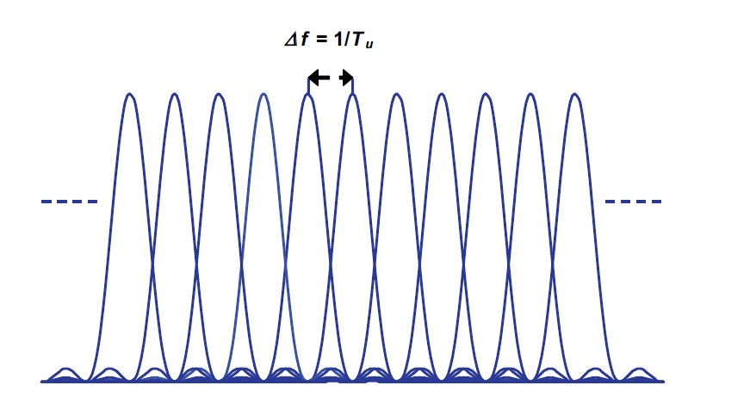
OFDM Basics
OFDM represents a multi-carrier transmission technique that uses a large number of relatively narrow subcarriers (order of hundreds)
Frequency domain: Tightly packed subcarriers with a subcarrier spacing equal ∆f = 1/T_{u} where T_{u} is per-subcarrier modulation symbol duration
Figure: This figure is taken from E. Dahlman, S. Parkvall, J. Skoll: “4G LTE/LTE-Advanced for Mobile Broadband,” Academic Press (Elsevier), 2011 (Figure 3.2, page 28)

Slide 25
OFDM Basics
OFDM subcarrier spacing is selected based on the propagation environment (time dispersion, Doppler spread)
Number of subcarriers usually depends on the available bandwidth and adopted subcarrier spacing
In 3GPP LTE, subcarrier spacing is selected to be ∆f = 15 kHz
In 3GPP LTE, number of subcarriers depend on the signal bandwidth, and is equal e.g. 600 subcarriers for 10 MHz LTE signal

Slide 26
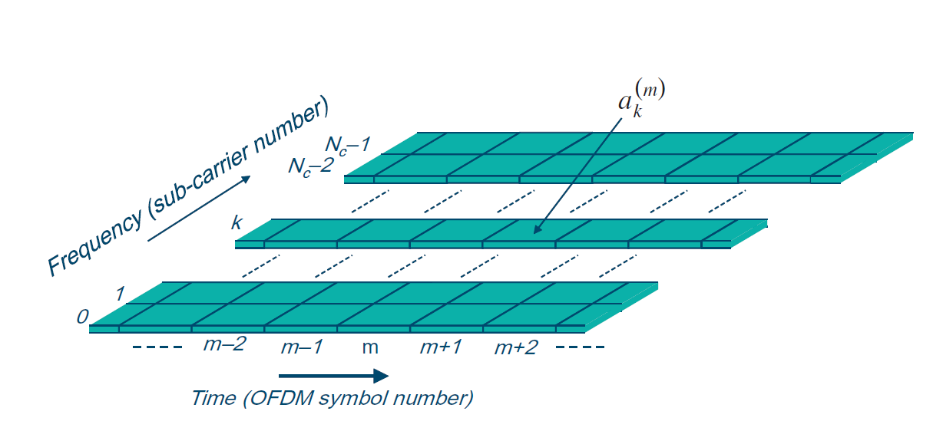
OFDM Resource Grid
OFDM symbol is a column in Resource Grid
It contains modulation symbols (QPSK, QAM)
LTE subframe contains 14 OFDM symbols
Figure: This figure is taken from E. Dahlman, S. Parkvall, J. Skoll: “4G LTE/LTE-Advanced for Mobile Broadband,” Academic Press (Elsevier), 2011 (Figure 3.4, page 30)

Slide 27
OFDM Implementation Using FFT/IFFT
OFDM symbol is thus a complex column-vector in frequency domain
Inverse Fast Fourier Transform (IFFT) is used to convert it to discrete time complex baseband signal domain
OFDM Modulation Steps
For each column-vector (OFDM symbol) in a subframe perform IFFT
For each obtained row-vector add cyclic prefix (see later)
Concatenate all 14 cyclic-prefixed time-domain OFDM symbols to obtain 1ms of LTE signal to be transmitted
Figure: This figure is taken from E. Dahlman, S. Parkvall, J. Skoll: “4G LTE/LTE-Advanced for Mobile Broadband,” Academic Press (Elsevier), 2011 (Figure 3.6, page 31)

Slide 28
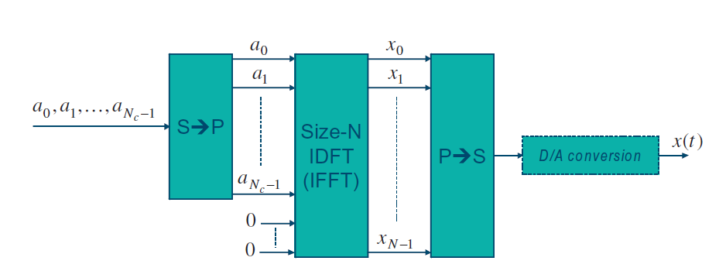
OFDM Implementation Using FFT/IFFT
The size of the IFFT N is usually taken to be the smallest power of two which satisfies N > N_{c} (number of OFDM subcarriers), due to applicability of fast transforms.
Example
10 MHz LTE signal contains 50 RBs or N_{c} = 600 OFDM subcarriers
N = 1024 is selected for IFFT size
Each subframe (14 OFDM symbols) is converted into 15360 complex samples (including cyclic prefixes)
This corresponds to the sampling rate of 15.36 M samples per second
Figure: This figure is taken from E. Dahlman, S. Parkvall, J. Skoll: “4G LTE/LTE-Advanced for Mobile Broadband,” Academic Press (Elsevier), 2011 (Figure 3.6, page 31)

Slide 29
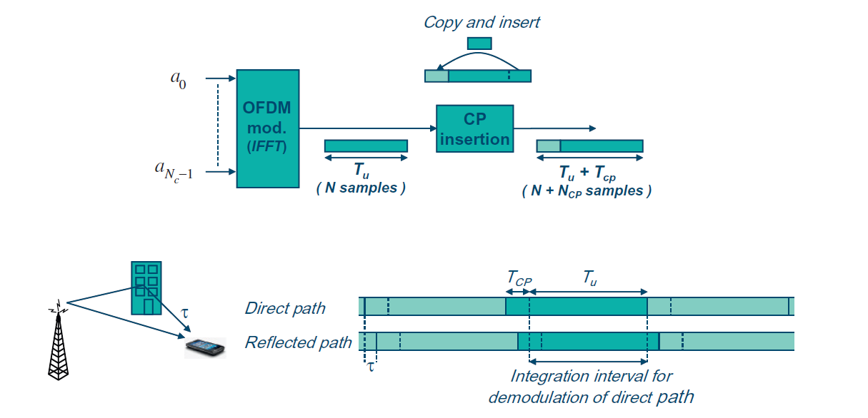
OFDM Cyclic Prefix
Cyclic prefix insertion is a solution for multi-path channels
Orthogonality is preserved if time dispersion span is shorter then cycle prefix duration
Figure: This figure is taken from E. Dahlman, S. Parkvall, J. Skoll: “4G LTE/LTE-Advanced for Mobile Broadband,” Academic Press (Elsevier), 2011 (Figure 3.9, page 34)

Slide 30
4G LTE PHY Signal Processing
0
1
0
0
0
1
1
0
1
0
1
1
0
K bits
MAC
PHY
Turbo Codes
CRC, FEC CODING, RATE MATCHING, SCRAMBLING
0
1
0
0
0
1
1
0
1
0
1
1
0
0
1
0
1
1
0
N bits
MODULATION, RESOURCE GRID MAPPING
QPSK, 16-QAM, 64-QAM
PHY signals
PHY channels
OFDM MODULATION
RF

Slide 31
Radio Frequency (RF) Part
After OFDM modulation, discrete-time complex LTE signal is ready for transmission
Complex (so called I/Q) samples are streamed to RF unit
RF unit performs Digital-to-Analog (DAC) conversion, upconversion to carrier frequency and the resulting signal is sent to antenna
In MIMO case, multiple parallel streams are created, one processing chain for each antenna
Figure: This figure is taken from E. Dahlman, S. Parkvall, J. Skoll: “4G LTE/LTE-Advanced for Mobile Broadband,” Academic Press (Elsevier), 2011 (Figure 3.6, page 31)

Slide 32
Open RAN Initiative
O-RAN considers disaggregated base station architecture
CU – Central Unit
DU – Distributed Unit
RU – Radio Unit
CU and DU are virtualized and softwarized in cloud/edge servers
NG-RAN
NR-Uu
UDP
PDCP
IP
UPF
PHY LOW
RLC
SDAP
MAC
PHY HIGH
L2
MH
RRC
L1
FH
BH
UE
RU
DU
CU

Slide 33
Takeaway Message
We reviewed the basic of OFDM modulation scheme used in 4G LTE and also the waveform of choice in 5G
We explained how LTE OFDM signal is organized in both time and frequency domain and explained resource grid structure consisting of resource blocks and subframes

Slide 34
Introduction to Modern Cellular Networks Part 6: 4G LTE Radio Interface – Part 2
Dejan Vukobratovic, Professor

